Slide 1
Regi Barosa
rbarosa@us.ibm.com
Ronald Geraghty
Ronald.Geraghty@ibm.com
Wilbert Kho wilbert@us.ibm.com
DevOps on Z PoT
Proof of Technology
DevOps Solution for Z Development
November 2020
/ © 2020 IBM Corporation
Notes:
An IBM Proof of Technology
Go to 'View > Header and Footer' to change this to match the event title
1
The objective of this session is to demonstrate through hands-on workshops, the power of collaborative development and delivery enabled by the IBM DevOps for z Systems solutions. Application teams can learn how they can quickly discover, understand and modernize their application portfolio in a managed fashion using a modern interface and a standardized process. Production teams can learn how they can reuse, extend and automate their existing build and deployment solutions for enterprise applications.

Slide 2
Audience
This Proof of Technology is targeted to, but not limited to Architects, Technical Specialists or Developers
Non-technical attendees with an understanding of application lifecycle management are welcome
Pre-requisites
Familiarity with z/OS concepts
Awareness (not necessarily proficiency) of basic z/OS System Programming tasks
Basic familiarity with JCL concepts (JCL skills NOT required)
No Java, COBOL or PL/I skills are required
Developers are welcome
Notes:
06/15/11
An IBM Proof of Technology
Go to 'View > Header and Footer' to change this to match the event title
2
An IBM Proof of Technology
Discovering the Value of IBM Rational Developer for System z version 7.6
2
Who should participate
This Proof of Technology is targeted for Architects, Technical Specialists or Developers. However, it is not limited to technical representatives. Some Cobol and IBM z Systems experience or understanding is required.

Slide 3
Proof of Technology Objectives
The objective of this session is to demonstrate through hands-on workshops, the power of collaborative development and delivery enabled by the Enterprise DevOps solutions. Application teams can learn how they can modernize their application portfolio using modern technology and tools. We will focus on code and build, automate unit testing and deploy. Production teams can learn how they can extend and automate their existing build and deployment solutions for enterprise applications
Areas covered:
Integrated application development and problem analysis (ADFz)
Managing your source code using modern technology (including Git)
Building automation (DBB) for COBOL or PL/I without a specific source code manager but using a pipeline automation tool (including Jenkins )
Using a unit testing framework (zUnit) for COBOL or PL/I as part of the development and build environment.
Application deployments automation to many environments ( UCD)
Expose Mainframe legacy applications via RESTful APIs (z/OS Connect)
Measure and report on how system resources are used by mainframe applications to improve performance (APA)
Notes:
An IBM Proof of Technology
Go to 'View > Header and Footer' to change this to match the event title
3
An IBM Proof of Technology
Discovering the Value of IBM Rational Developer for System z version 7.6
3
POT Objectives
This Proof of Technology session provides attendees with basic skills and hands-on exposure to some features of IBM DevOps framework.
We will cover technologies like:
Application Delivery Foundation for z Systems (ADFz)
Urban Code Deploy (UCD)
IBM z/OS Connect Enterprise Edition
The labs will also use z Systems Development and Test Environment (zD&T) as our z/OS system.
Attendees will have an opportunity to work with the IBM software and evaluate the offering for use on their mainframe systems.

Slide 4
Agenda - Day 1
10:00 Introduction to DevOps on IBM Z - focus on open source tools (Ron)
10:40 LAB 1 - Working with z/OS using COBOL and DB2 or LAB7 - IBM DBB with Git, Jenkins and UCD on Z
12:50 Checkpoint - Comments and Closing Day 1 (Ron/Wilbert/Regi)
10:00 zUnit and Wazi VTP Overview (Wilbert)
10:15 Demo: Scenario using Z DevOps solutions including zUnit, Git and Jenkins (Regi)
11:00 – 12:50 Choose one Optional lab:
→ LAB 7 - IBM DBB with Git, Jenkins and UCD on Z (1 hour)
→ LAB 6B : Using IBM zUnit to Unit Test a COBOL CICS application (1 hour) → LAB 2D: z/OS Connect EE toolkit – Create/deploy Service and API for Catalog Manager App → LAB 5: UCD – Create UrbanCode Deploy infrastructure and deploy to z/OS → LAB 8 - Using Application Performance Analyzer (APA)
12:50 Checkpoint - Comments and Closing Day 2 (Ron/Wilbert/Regi)
Agenda - Day 2
Lecture
Labs

Slide 5
DevOps is not one of these things… It’s all of them!
People
Process
Tools
DevOps is a set of practices that combines software development (Dev) and IT operations (Ops). It aims to shorten the systems development life cycle and provide continuous delivery with high software quality.
/ © 2020 IBM Corporation
Notes:
Like any transformational exercise, a transformation to a continuous delivery model support by DevOps involves three key things:
People: Organizational culture, behaviors
Process
Tools
Tools simply enable the transformation and help reinforce the process.
Process provides a framework, a set of guidelines and best practices to help you adopt lean and agile principles in a continuous delivery model.
Now, people – that’s the tough part! Change is hard and transformational change is even harder. Don’t underestimate the need to focus on the people, which includes organizational structure, roles, ownership, behaviors and cultural differences that exist in your environment.
(Optional, if you want to mention this) In VersionOne’s state of agile survey, 3 of the top 4 barriers to adoption were related to the people aspect:
1. Inability to change organizational culture (53%) and
2. General resistance to change (42%)
4. Availability of personnel with the right skills

Slide 6
Why DevOps for z/OS?
Client Value through increased quality
Automated test (at any level) at code delivery and
Code reviews will include results of build, package and tests
Modernizing to industry standard tools
Enables z/OS to leverage relevant open source tooling. E.g Jenkins and Git
Unlocks an ecosystem not currently available to z/OS dev *
Decreased time to market
Retention and Skills
New hires start out knowing some of the DevOps tools
Using homegrown, hard to maintain, proprietary tools is a problem
Lack of automation increases the time until a new team member is contributing fully
Current tools support not sustainable
/ © 2020 IBM Corporation

Slide 7
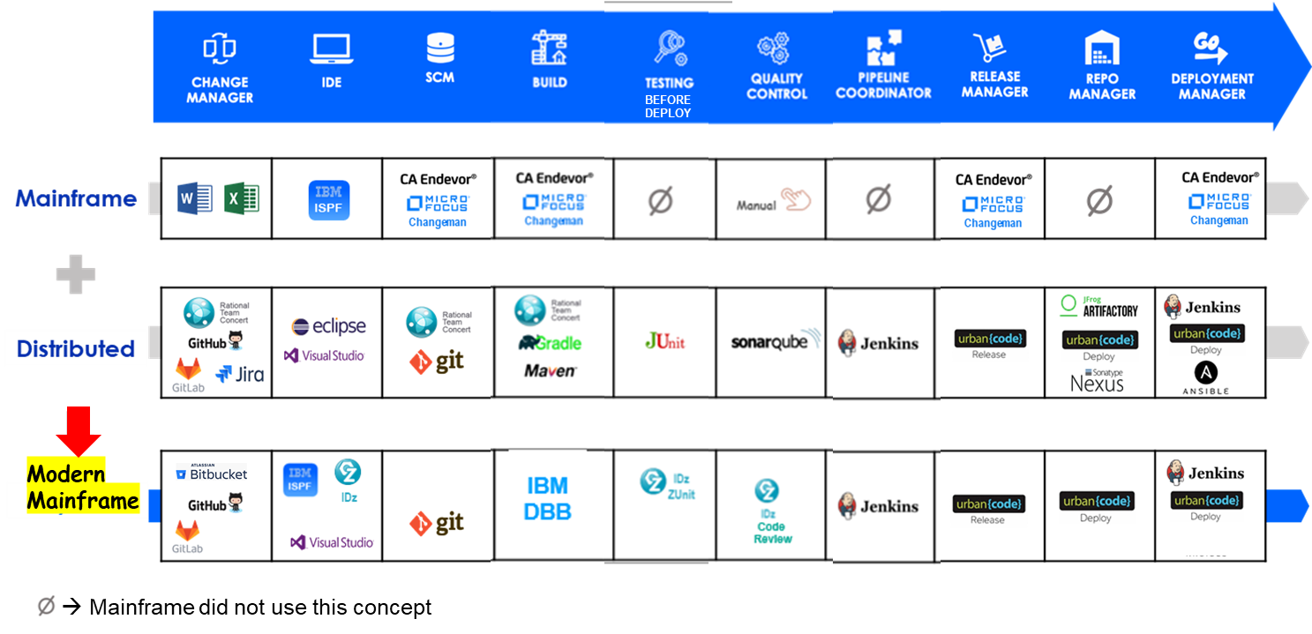
Imagine a unified Pipeline on Z/OS
/ © 2020 IBM Corporation

Slide 8








How to justify DevOps? The value of early and extensive testing
“80% of development costs are spent identifying and correcting defects” **
Once released into production
$7,600/defect
+
Law suits, loss of customer trust,
damage to brand
During Quality Assurance or the System Test phases
$960/defect
During the BUILD phase
$240/defect
During the Coding or Unit Testing phases
$80/defect
**National Institute of Standards & Technology
Source: GBS Industry standard study
Defect cost derived in assuming it takes 8 hours to find, fix and repair a defect when found in code and unit test. Defect FFR cost for other phases calculated by using the multiplier on a blended rate of $80/hr.
/ © 2020 IBM Corporation
Notes:
8
8

Slide 9
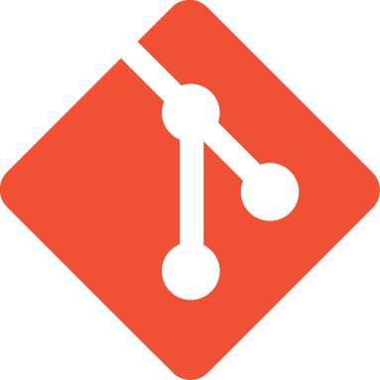



What is Git
A distributed, open source version control system
Runs on all platforms (z/OS, Linux, Windows, Mac)
z/OS uses Rocket® Open Source implementation on USS
Command line interface
Community supported
The de-facto standard for software development
Integrated into many tools
Jenkins, Slack, Urban Code Deploy, Ansible, Artifactory, Jira, JUnit, Maven, Gradle, Make, DBB, Azure and many more.

Slide 10
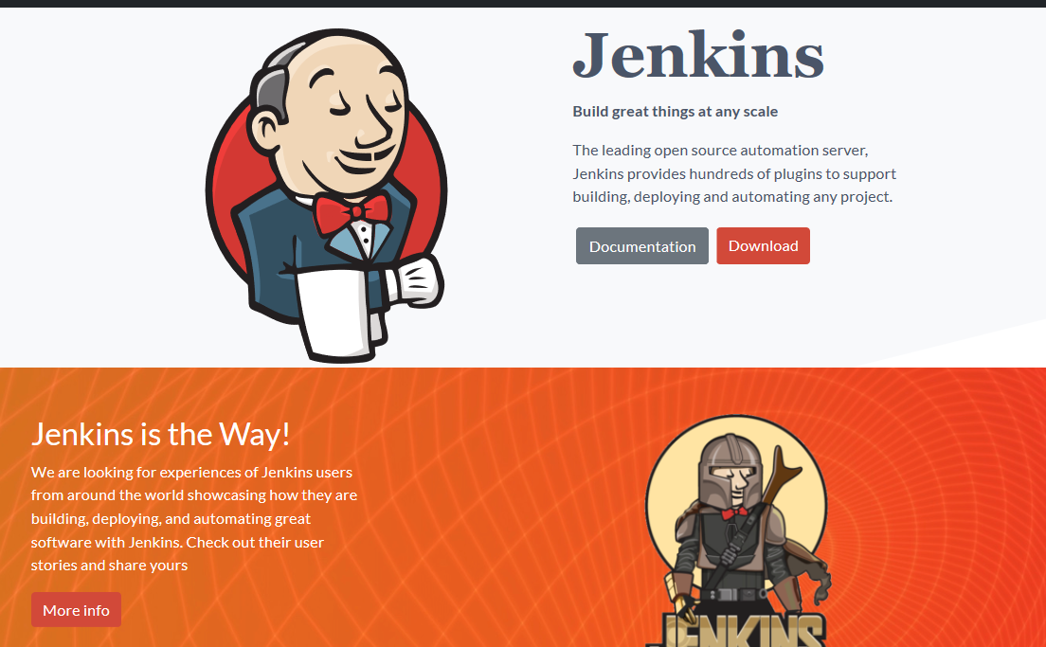
What is Jenkins?
“Jenkins is a self-contained, open source automation server which can be used to automate all sorts of tasks related to building, testing, and delivering or deploying software.”
Ref: https://www.jenkins.io/doc/
Note: Jenkins is not the only orchestrator. You can use Azure DevOps, TeamCity, Bambo ...

Slide 11
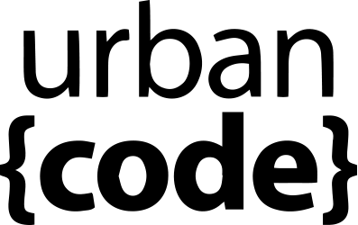




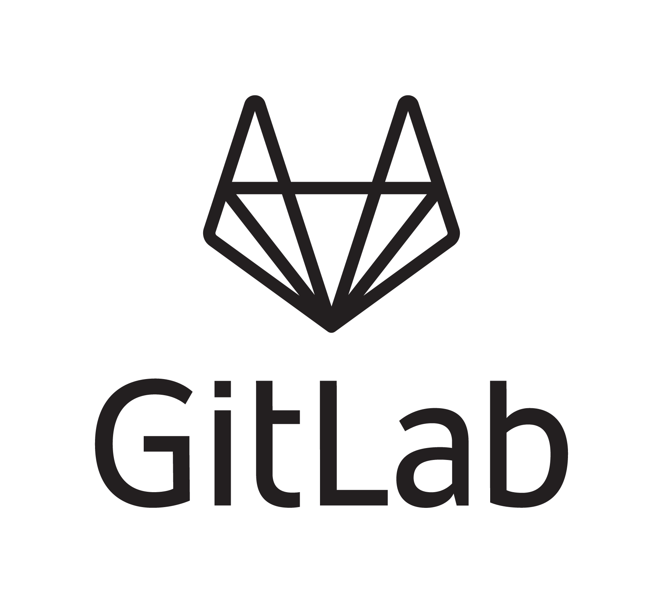










Z DevOps Pipeline
LEGEND
Eclipse, VS Code, Eclipse Che (BYOI) IBM Developer for z/OS Enterprise Edition (IDzEE)
IBM Wazi Workspaces (Code)
Dependency Base Build (IDzEE)
ZUnit (IDzEE)
IBM Wazi Virtual Test Platform
IBM Z Development and Test Enviroment (ZD&T)
IBM Wazi Workspaces (Sandbox)
IBM z/OS Cloudbroker
IBM Optim Test Data Managament
IBM Rational Test Workbench
Analyze
uBuild
Feedback, approvals
Note: Starting from the upper left, products and significant capabilities appear once, the first time they are used in the pipeline. Products and capabilities are used at multiple points.
https://galasa.dev/
+
Code
Build and Test
Provision
Deploy
Test
End to end DevOps The IBM way Open and Flexible
CI/CD Pipeline
Analyze
Plan
Monitor
Release
IBM Application
Discovery and Delivery
Intelligence
IBM Engineering Workflow Management
IBM Z APM Connect
OMEGAMON
Operational Insights
/ © 2020 IBM Corporation

Slide 12
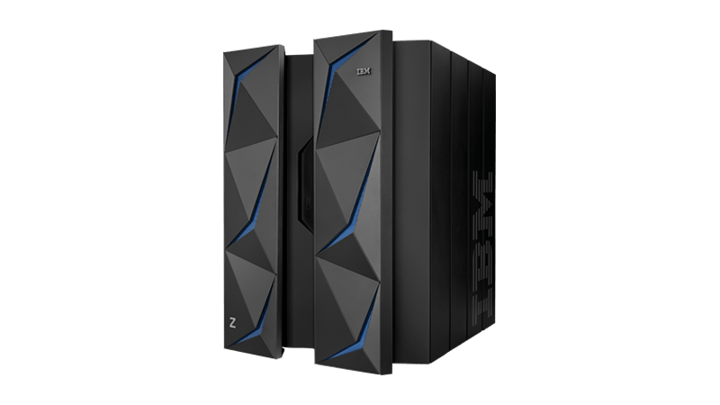
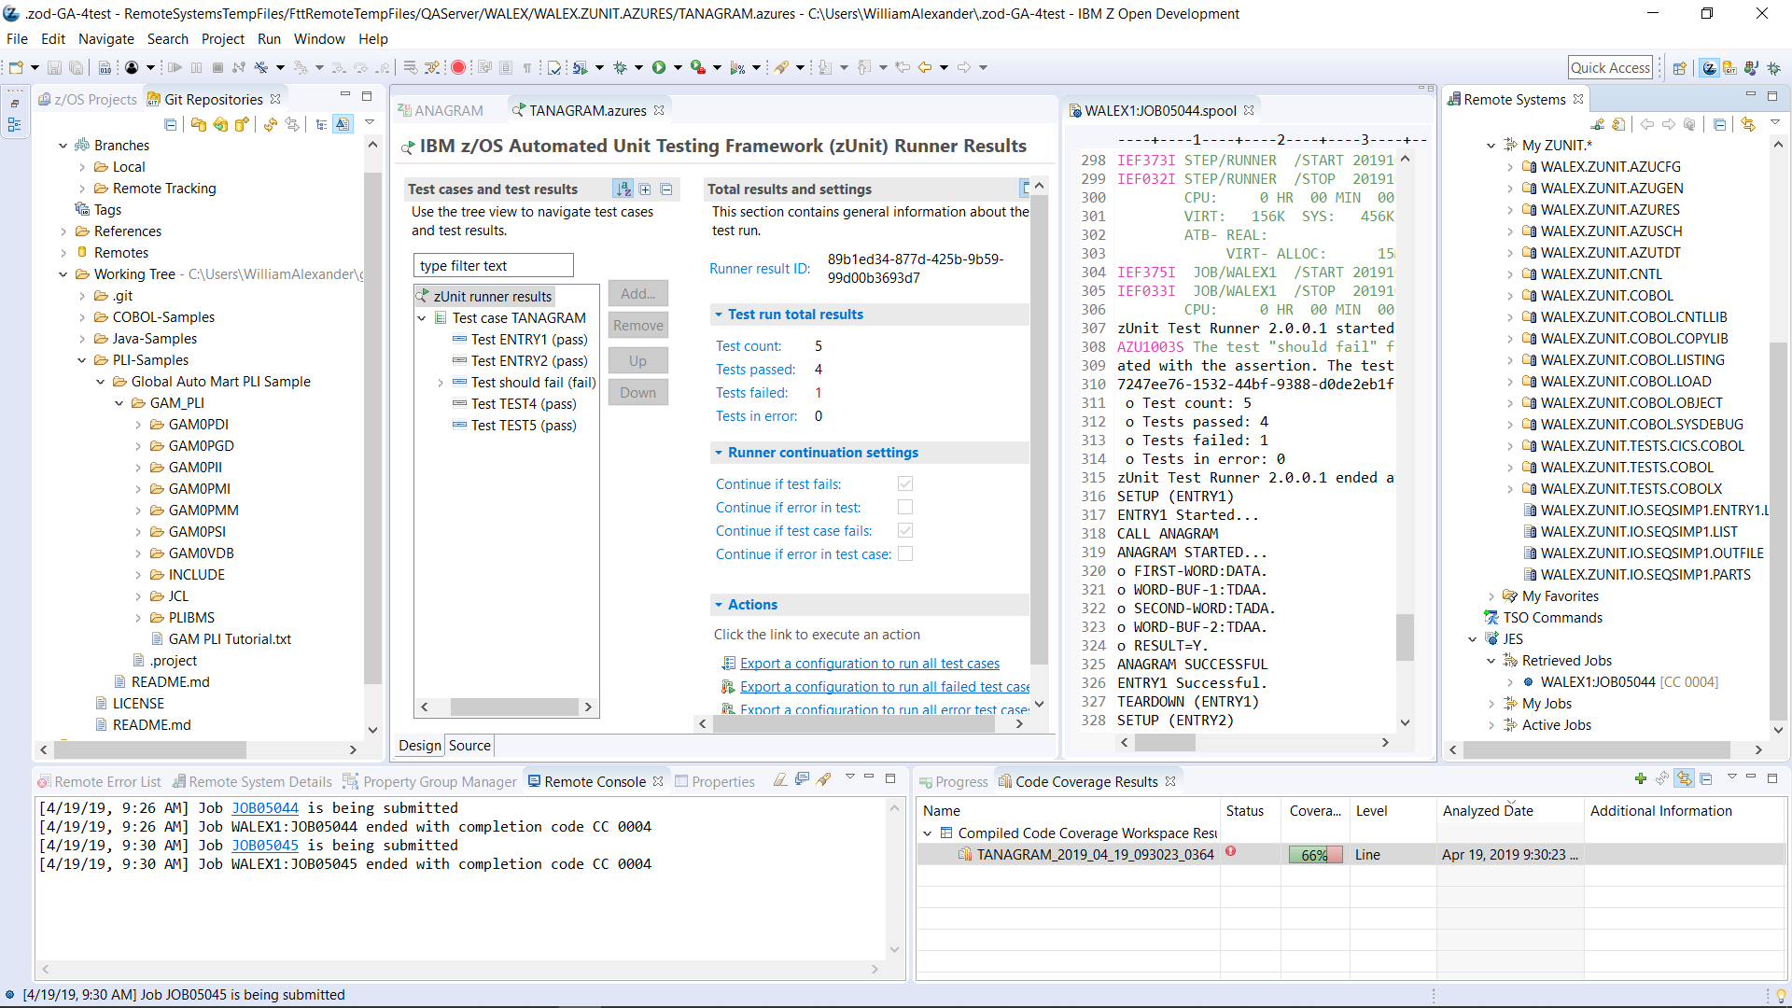
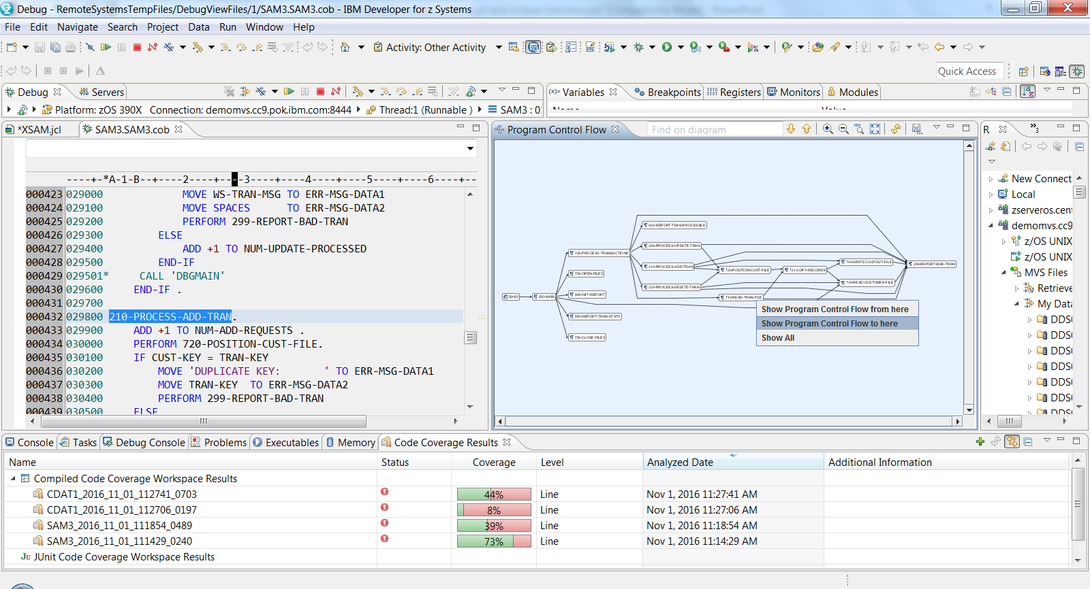
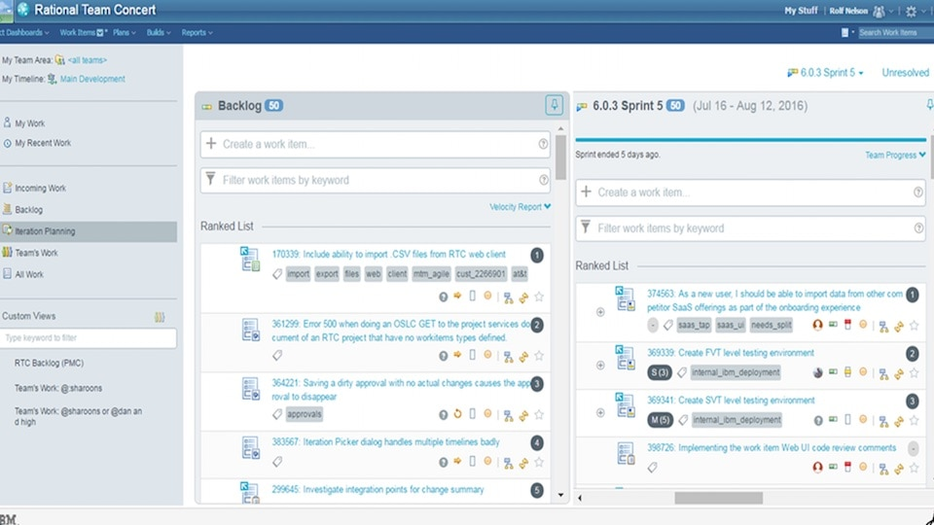
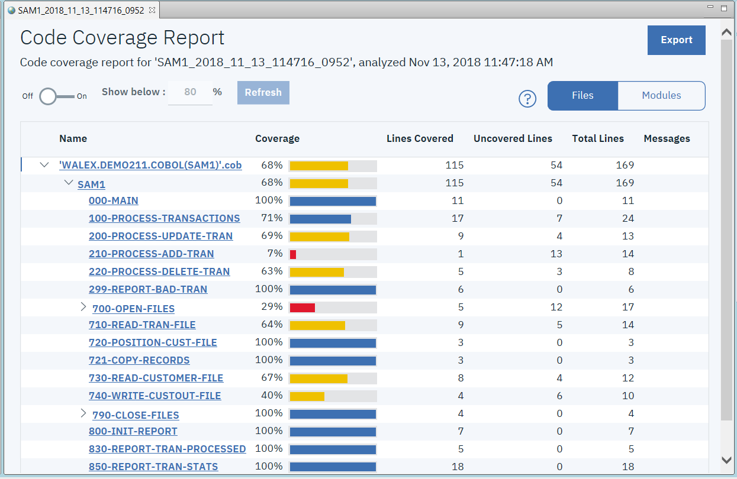
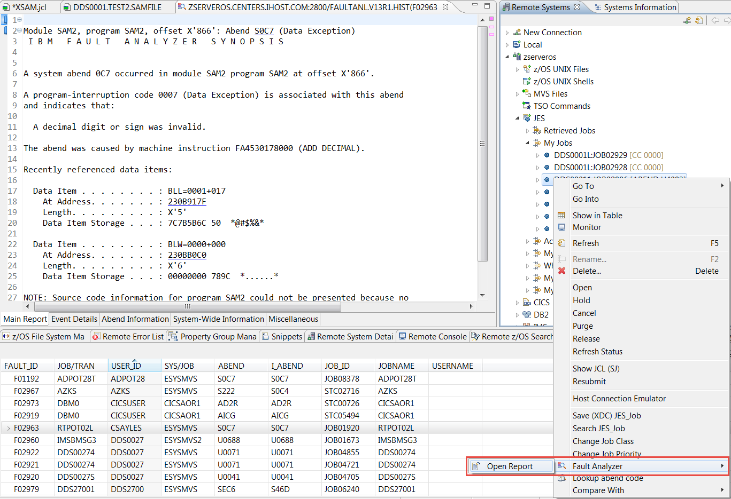
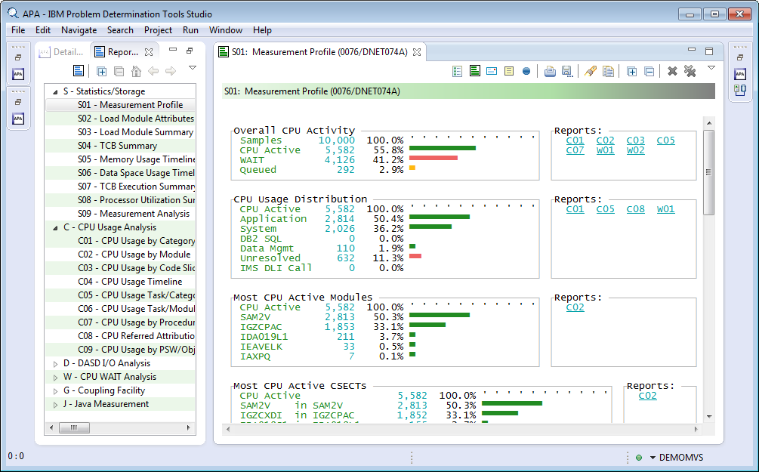
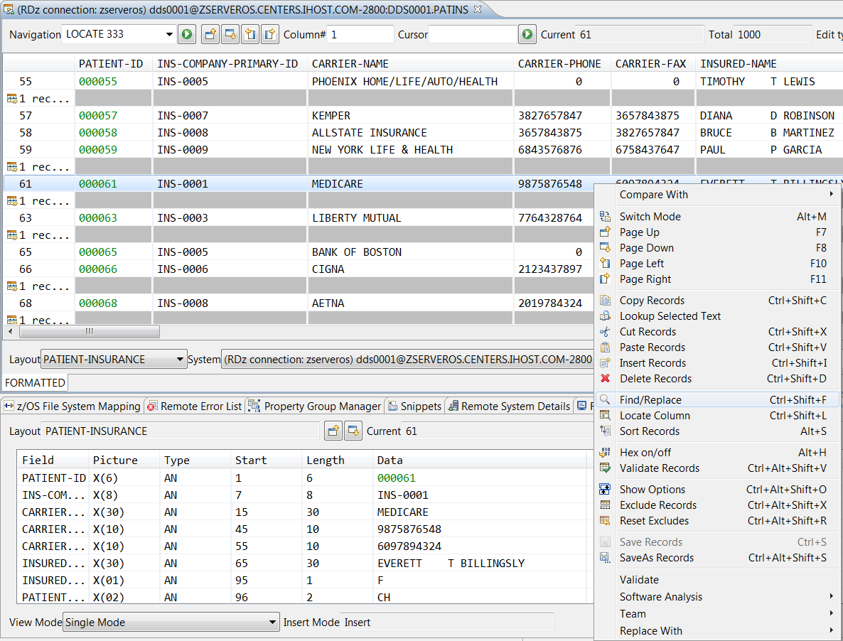
z/OS and subsystems
IMS
CICS
Unit test and code coverage
IBM Developer for z/OS Enterprise Edition- the developer's cockpit!
Build and SCM
Integration with Git for Lifecycle and Source Management
Abend analysis
Performance analysis
File Management
/ © 2020 IBM Corporation
Notes:
In addition to the essential program analysis, edit, build, test, and debug capabilities that developers need, the z/OS IDE also serves as the main integration point into the other activities that developers need to do- whether it is to access files on the mainframe, understand application-wide dependencies and metrics, or work with a modern SCM or a legacy library manager to extract the latest code and integrated it back to the shared repository. Plus, IDz offers in context integration with File Manager to perform file management, Fault Analyzer to perform abend analysis, plus Application Performance Analyzer to perform performance analysis. This in context integration helps preserve flow from one activity to another.

Slide 13
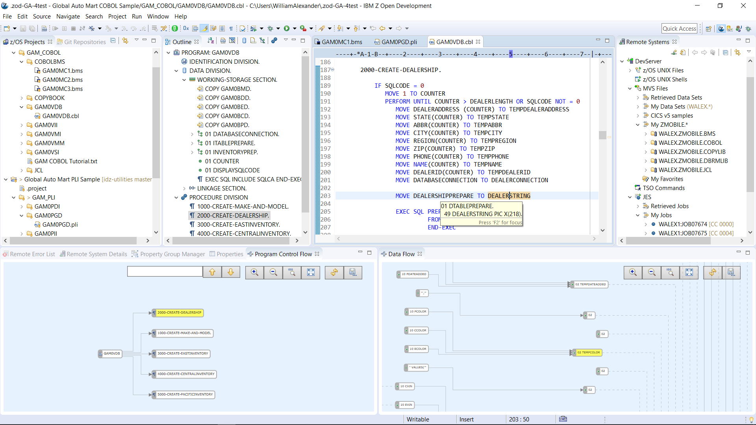
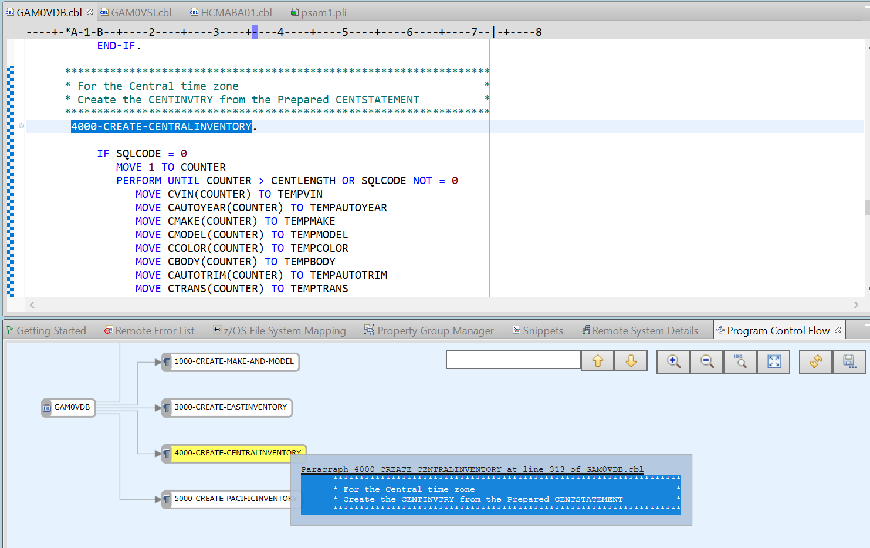
Analyze (program understanding)
Outline view
Outline view
Show high level abstraction of source
Program control flow
Graphical view of program logic
Data flow diagram
Graphical view of data movement throughout the program
Powerful local and remote search capabilities
New! Web UI look and feel
Program control flow
Data flow
New! Hover improvements, showing comments associated with a paragraph, section or procedure
/ © 2020 IBM Corporation
Notes:
As Deb begins to make changes to her application code, she needs to understand the code she is changing. IDz has many features to help with program analysis. There is an outline view that shows the structure of the program that Deb can easily use to navigate from one area to another, vs scrolling or finding.
Or, if Deb prefers working visually, she can use the program control flow and the data flow diagram to see the structure, and easily navigate the program. New in the past year is an improved UI that is more “web like”.
Along with this change, you can also now hover over the nodes of the program to see the comments to gain more of an understanding of the underlying code.
The Data flow diagram can help with impact analysis by enabling an visual trace of the data through the program.
And in addition, there are various ways to filter your program source to hone in on areas of interest.
In addition, there are powerful search capabilities that span programs and PDS, whether that is looking for variables or strings.

Slide 14
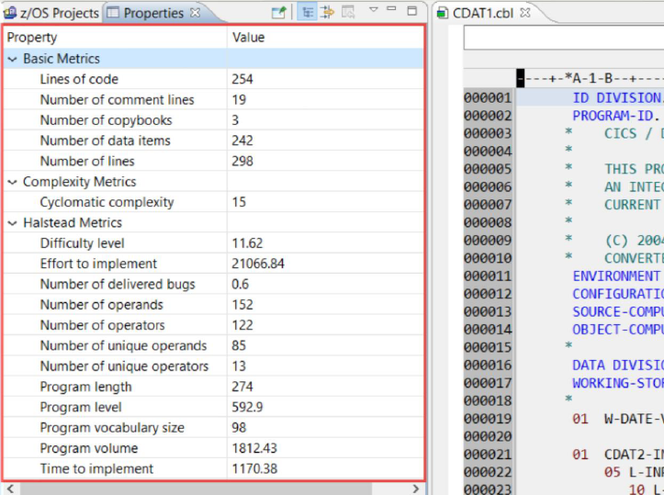
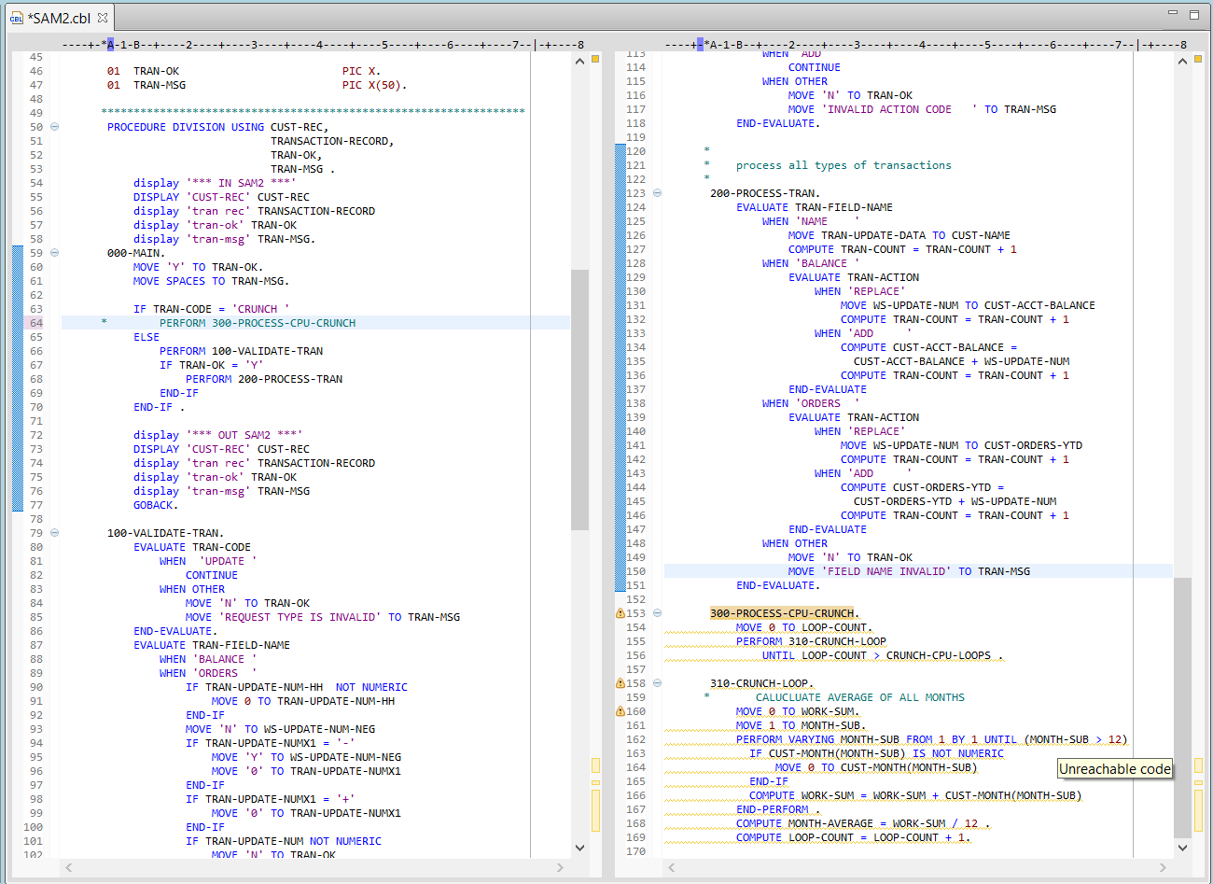
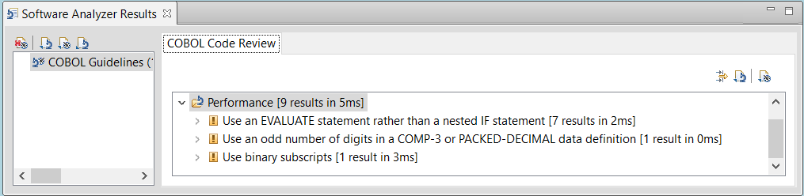
Analyze (code rules and statistics)
Code rules
Code rules
Electronic desk checking
Can be run in batch as part of a pipeline
Customizable
Program level statistics
Base metrics
Complexity
Halstead
SonarLint integration
Program statistics
New! Unreachable code automatically identified when a COBOL program is opened for edit
Could be used in a Pipeline (like Jenkins) via Batch execution to enforce standards
/ © 2020 IBM Corporation
Notes:
IDz has code rules and program level statistics. These rules ensure that the program source adheres to best practices and your shop standards. In addition, they are extensible. We provide some wizards so that you can build rules yourself.
Plus we have program statistics- to give you at a glance an idea of the size and complexity of the program. If you want to persist that information over restarts of the IDE, this is something new in the past year- so you can easily pick up where you left off.
And we also made the identify unreachable code feature happen automatically- so that when you open a program, you see this and can do some clean up to reduce technical debt while you are working on an area of code.

Slide 15
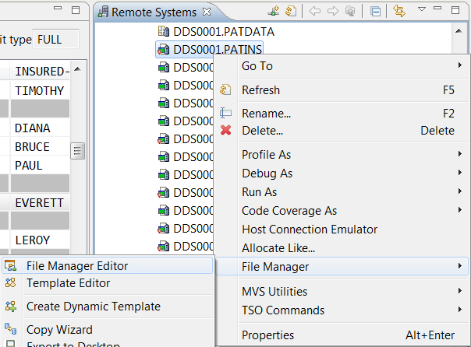
ADFz: “File Manager (FM)” Edit file types
Copy/Field records
Different record types in dataset
Sample
Sort
Fixed, Variable
HFS files
Sequential (PDS and PDSE
VSAM (including IAM)
Websphere MQ messages on a queue
CICS: TS or TD queues
Access VSAM Files directly from IDz Edit
(Remote Systems view)
Comprehensive File Editing options
Single and Tabular records view/edit
Edit through copybook/schema

Slide 16
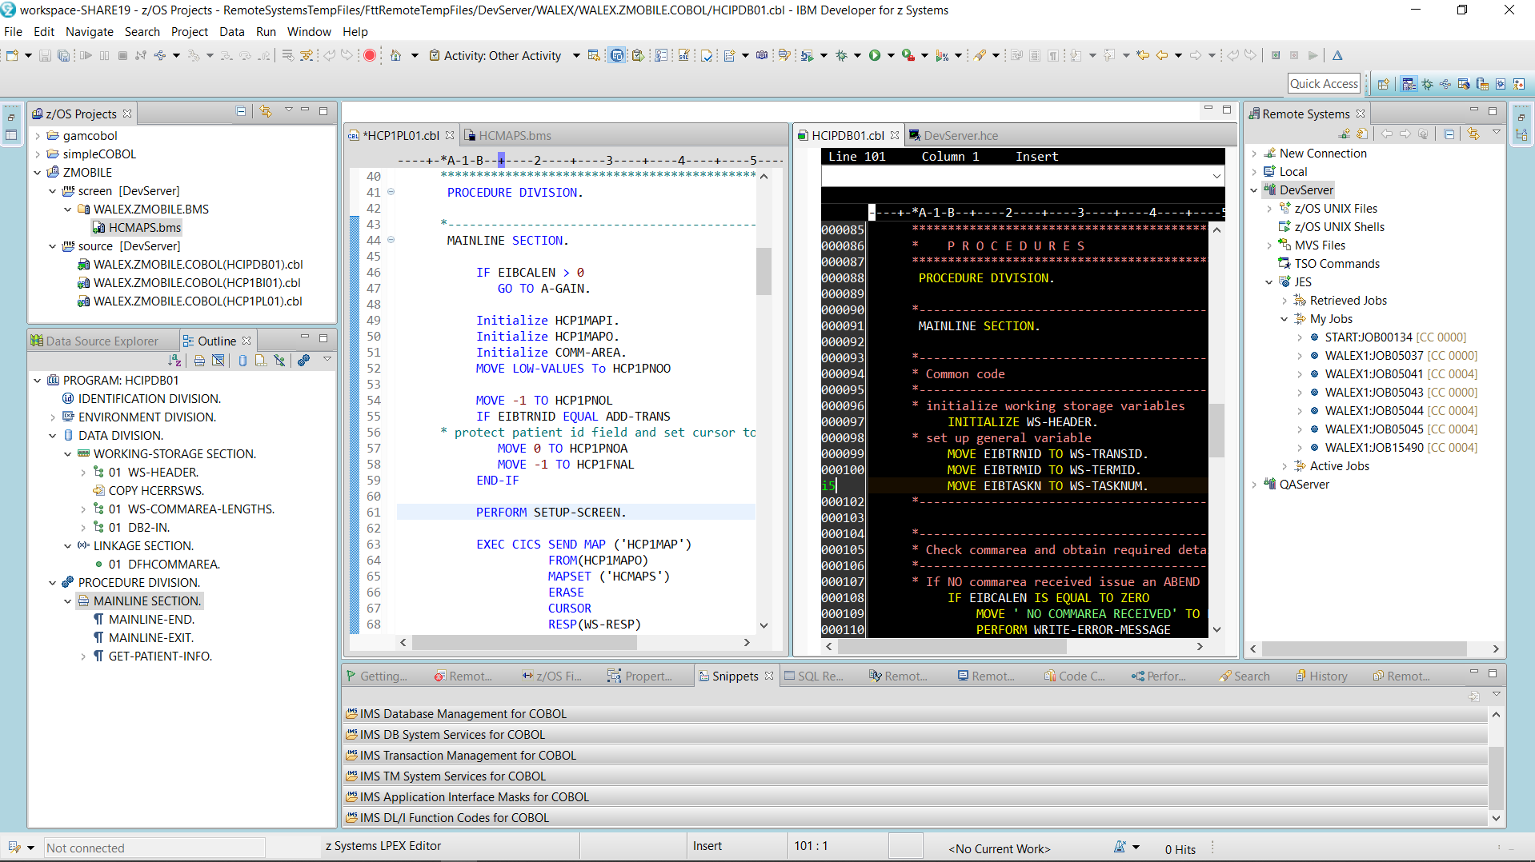
Edit
Traditional Eclipse style editors, plus ISPF-like LPEX editor with a command line and prefix area
Modern editor
LPEX Editor
/ © 2020 IBM Corporation
Notes:
Once Deb has determined the change she needs to make using the analysis capabilities, she moves to editing her code.
Developers like Deb have very distinct preferences.
If Deb has many years of ISPF experience, she may prefer the ISPF like LPEX editor. This has a command line and a prefix area and offers a smoother transition from ISPF.
Or, if Deb has used an IDE for another programming language, she may be accustomed to a modern editor style, and may prefer it.
The choice of editing style is very personal, and IDz gives you choices.

Slide 17
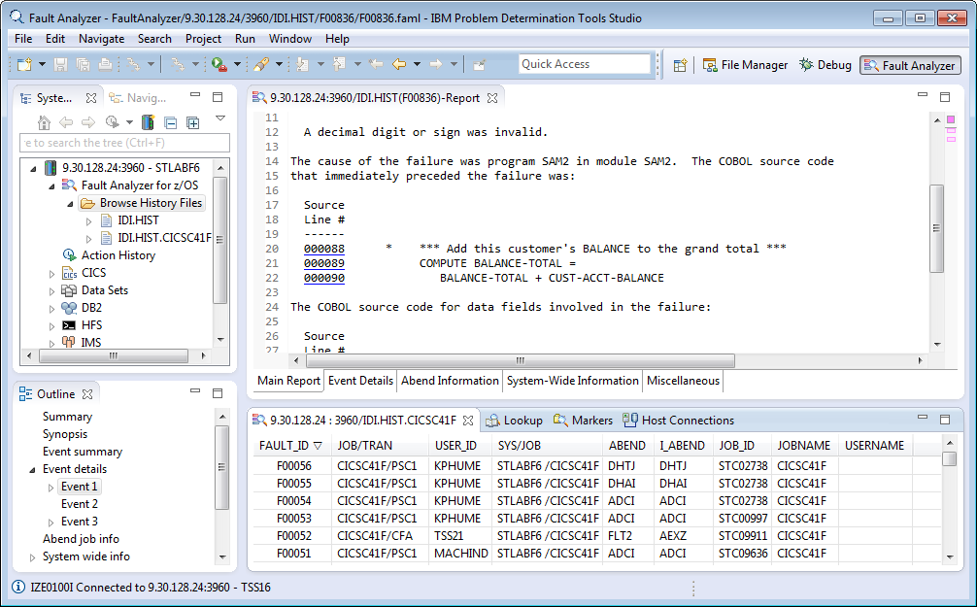
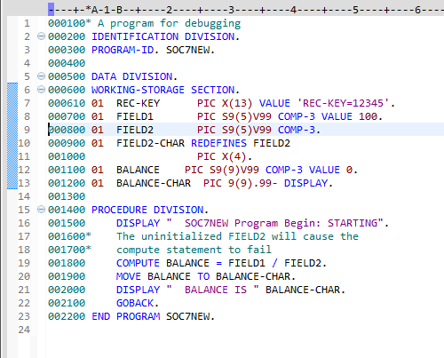
ADFz: “Fault Analyzer (FA)” for Program Failures
IBM Fault Analyzer improves developer productivity and decreases deployment costs by helping to analyze and correct application failures quickly (CICS,DB2,IMS,MQ,COBOL,PLI,ASM, C/C++,JAVA)
Automatic program abend capture and reporting
Program source-level reporting
Provides a detailed report about program failures to help resolve them quickly
Enables you to track and manage application failures and fault reports
Integration with ADFz and 3270-based Interface
Reports – Hyperlinks to program source file
Fault Analyzer history files
ABEND cause
Available
ABEND reports
Report Outline
Hyperlinks
List of fault (ABEND) entries
Notes:
Once “APA/GUI” is selected CICS Explorer changes to the Application Performance Analyzer perspective, this slide shows the perspective in the active mode.

Slide 18
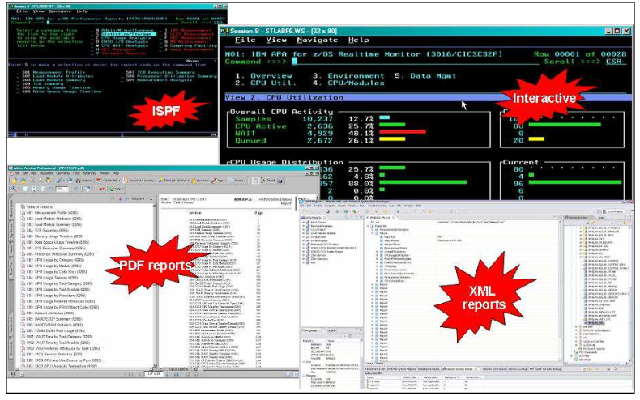
ADFz: Application Performance Analyzer (APA) for z/OS
Provides rapid pin-pointing of enterprise application bottlenecks
TSO
BATCH
IMS
CICS
DB2
DB2 SP & DDF
WAS
MQ Series
JAVA
USS
Adabas Natural
Observation Session
Displays overall system activity, enabling you to check job execution online and select which active job to monitor
Automatically starts to monitor job performance when the job or program becomes active
Provides multiple summary reports to assist in identifying key areas of performance bottlenecks
Print reports from z/OS
APA Observation Files
Application
Performance
Analyzer
ISPF or
GUI
View reports
in PDF format on PC or in XML reader
Integrated with ADFz and 3270-based Interface
View reports
online with ISPF or
GUI Interface
Specify number of times APA monitors a job’s performance when job or program becomes active
Invoke the monitoring capability from other programs such as IBM Tivoli® OMEGAMON
Compare two observation reports to see the relevant differences, to supplement threshold monitoring
Assembler, COBOL and PL/I statement usage within each module or disassembly for modules without source
DASD & Processor statistics
IMS/CICS transaction performance relationships to database
DB2 z/OS; Stored Procedures, SQL, DDF detailed DB2 delay information
IBM WebSphere MQ queue information
Notes:
Non-intrusive performance analyzer for applications and systems programmers to
Improve response time in online applications
Improve batch turn around time
Identify excessive I/O activity
Identify excessive CPU usage
Test the effects of increasing workload
Isolate performance problems in new and existing applications

Slide 19
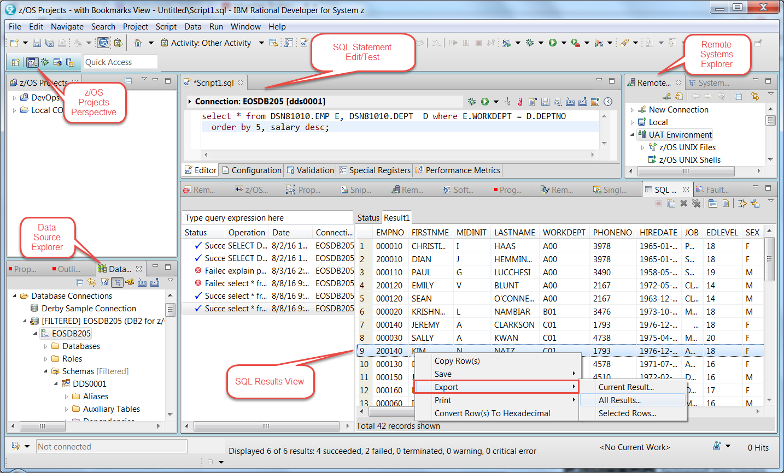
Data Studio : DB2 Development Tooling A flexible graphical interface to DB2 and SQL
DB2 Table/View/Index Analysis
DB2 Data Model and for Test Data Management and manipulation:
CRUD
Simple Table row/column sub-setting (sampling)
Test/Run/Tune SQL directly from COBOL or PL/I programs
Run existing SPUFI files (DDL, DML)
SQL code and Test
Code embedded SQL directly within COBOL, PL/I and Assembler programs
Statement content assist from the DB2 Catalog
Code SQL with graphical tooling
Interactively Code/Test/Tune SQL statements
Export SQL statement results to: Spreadsheets, HTML, XML

Slide 20
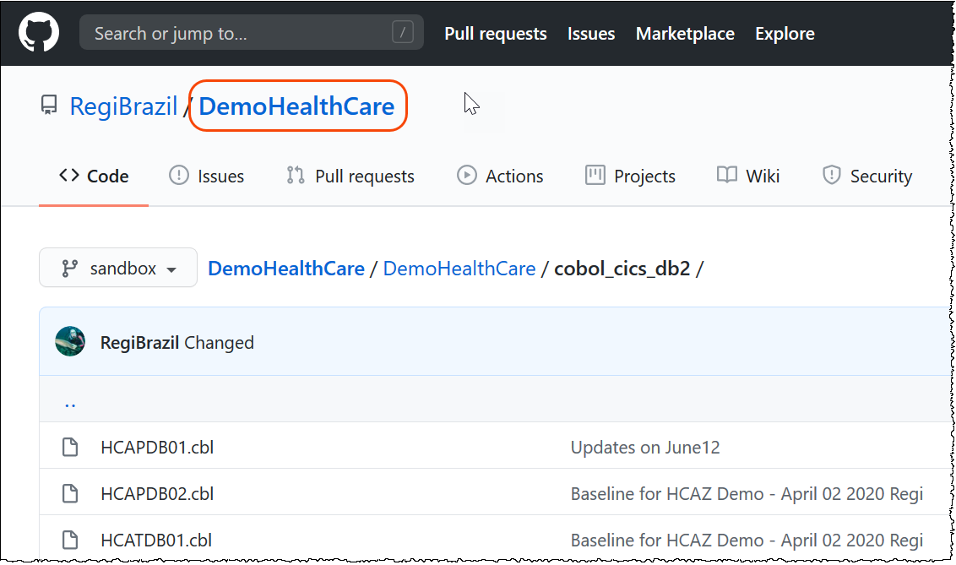
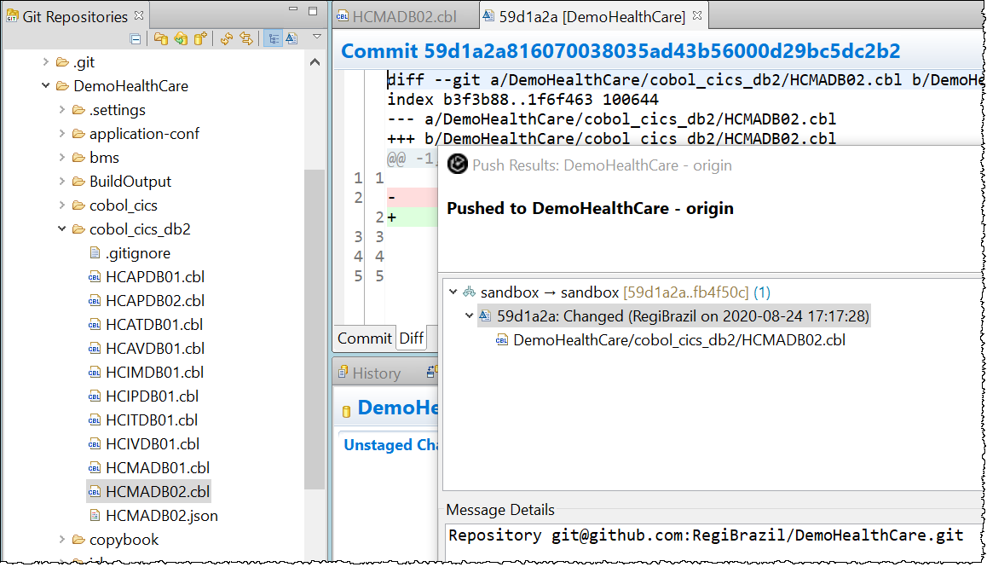
Source Code Management
IBM IDz offers out-of-the-box integration for the IBM Rational Team Concert, CA Endevor and IBM SCLM.
EGit included in IDz
20
/ © 2020 IBM Corporation

Slide 21
Z DevOps Pipeline
LEGEND
Eclipse, VS Code, Eclipse Che (BYOI) IBM Developer for z/OS Enterprise Edition (IDzEE)
IBM Wazi Workspaces (Code)
Dependency Base Build (IDzEE)
ZUnit (IDzEE)
IBM Wazi Virtual Test Platform
IBM Z Development and Test Enviroment (ZD&T)
IBM Wazi Workspaces (Sandbox)
IBM z/OS Cloudbroker
IBM Optim Test Data Managament
IBM Rational Test Workbench
Analyze
uBuild
Feedback, approvals
Note: Starting from the upper left, products and significant capabilities appear once, the first time they are used in the pipeline. Products and capabilities are used at multiple points.
https://galasa.dev/
+
Code
Build and Test
Provision
Deploy
Test
End to end DevOps The IBM way Open and Flexible
CI/CD Pipeline
Analyze
Plan
Monitor
Release
IBM Application
Discovery and Delivery
Intelligence
IBM Engineering Workflow Management
IBM Z APM Connect
OMEGAMON
Operational Insights
/ © 2020 IBM Corporation

Slide 22


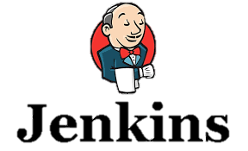





What is IBM Dependency Based Build (DBB)?
Provides a modern scripting languagebased automation capability that can be used on z/OS.
The DBB API can be called by Java based scripting languages such as Groovy, JRuby, Jython, Ant, Maven, Python, etc.
Consists of a build toolkit (Java API, Groovy Installation) installed on USS (z/OS) and a Liberty application server that hosts build metadata (dependency data, build results) installed on Linux.
Git server
DBB Liberty App
Dependency Data
Build Results
Branch release 2
z/OS
Branch release 1
DBB toolkit
Status, logs and links to reports
Agent
Build scripts
(scan, impact analysis, copy to PDS, compile, link-edit, bind, report)
USS
PDS
/ © 2020 IBM Corporation
© Copyright IBM Corporation 2020

Slide 23
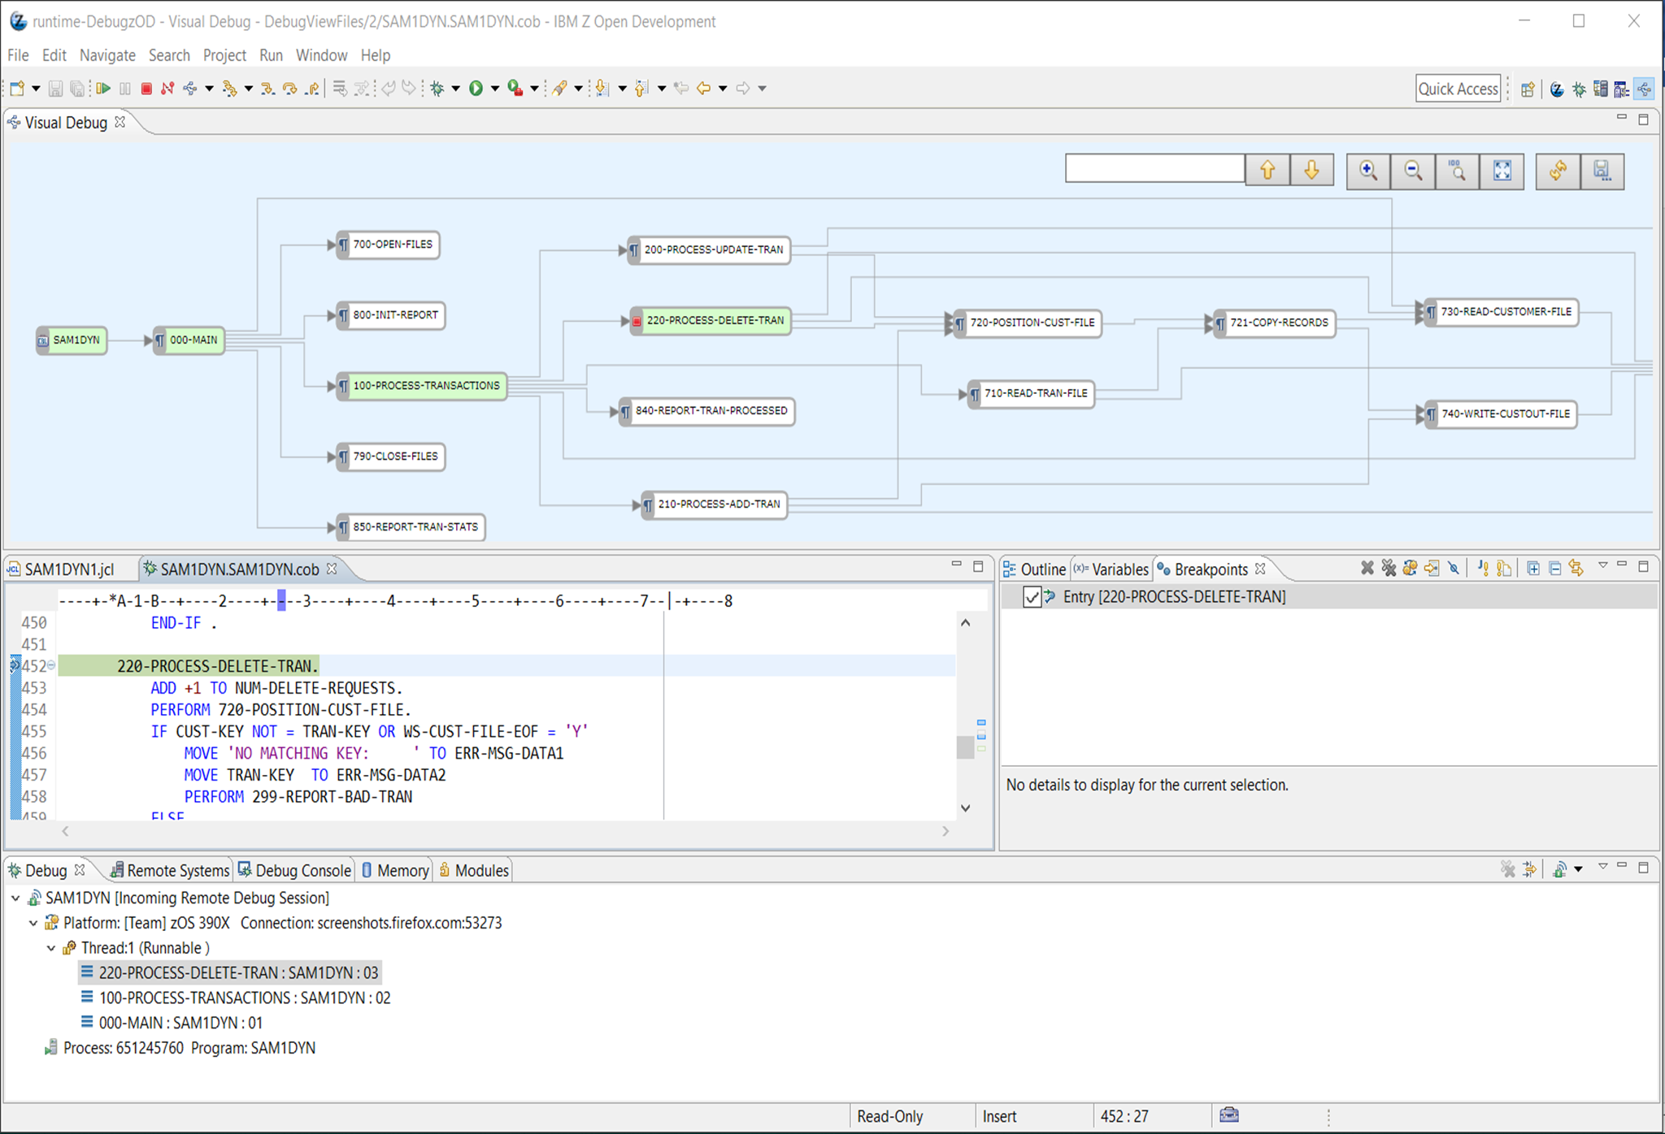
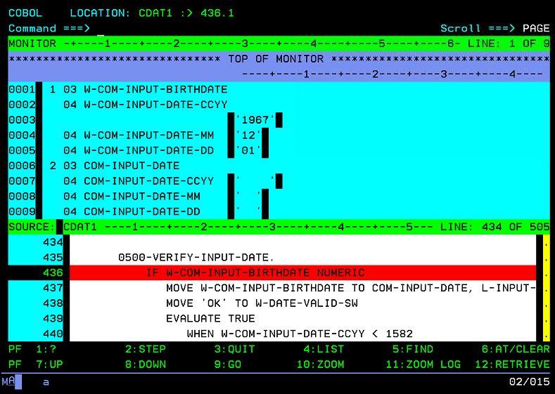
Diagnose (z/OS Debugger)
New! Web UI look and feel (14.1.5)
Program testing and analysis
Helps you examine, monitor, and control the execution of application programs on z/OS
With:
Visual debug
Code coverage facilities
Eclipse GUI
3270 UI (Debug for z/OS and IBM Developer for z/OS Enterprise Edition only)
Paragraph Stack Trace –
Follows program logic
/ © 2020 IBM Corporation
Notes:
So let’s talk about Debugging. We know that a debugger is designed to help you increase your application development efficiencies and assist in shortening the development and maintenance cycle time. For example, if your unit tests uncover some bugs in your program.
The IBM z/OS Debugger allows you to monitor your application while it’s running. You can look in on the execution one statement at a time or a series of statements at a time. You can also set breakpoints or stopping points and look in on the contents variables and alter the contents of the variables to change the processing path to test a specific section of code. You can stop in subroutines, add code on the fly to play what if games, along with a variety of additional functionality available to you.
IBM z/OS Debugger can be used in the various environments such as CICS, DB2, IMS and has language support for COBOL, PLI, C/C+, Assembler, and Java.
It has both an external code coverage facility as well as an internal code coverage feature that can be activated during your debug session. So if you want to perform coverage testing and be able to verify and prove that a section of your code has been exercised then the code coverage feature is available.
There are two interfaces available for the IBM z/OS Debugger- the traditional 3270 interface as well as an Eclipse-based interface.
If you use the z/OS Debugger in conjunction with IDz (Eclipse based), the visual debugging capability is surfaced, and this gives you an easy understanding of where you are in a complex program, where you have been, and where you might be going. Visual debug also has stack trace breakpoints- if there is a certain path in your program in which you know an error is happening- you can highlight the nodes within the visual diagram and set breakpoints. These breakpoints will hit ONLY if the specified logical path is being executed.
And IDzEE offers both Eclipse based debugging and 3270 debugging- so developers that are accustomed to 3270 can used the familiar 3270 interface while they are learning what IDz Eclipse based UI has to offer.

Slide 24
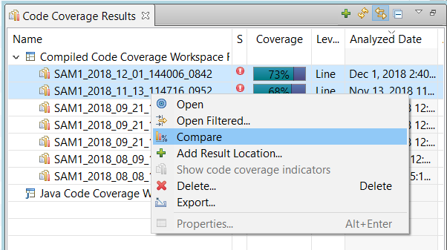
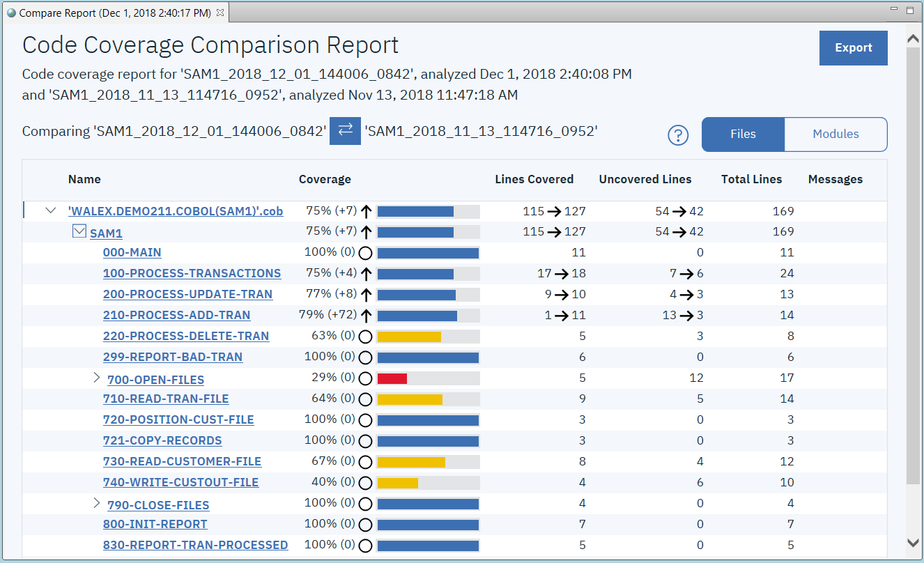
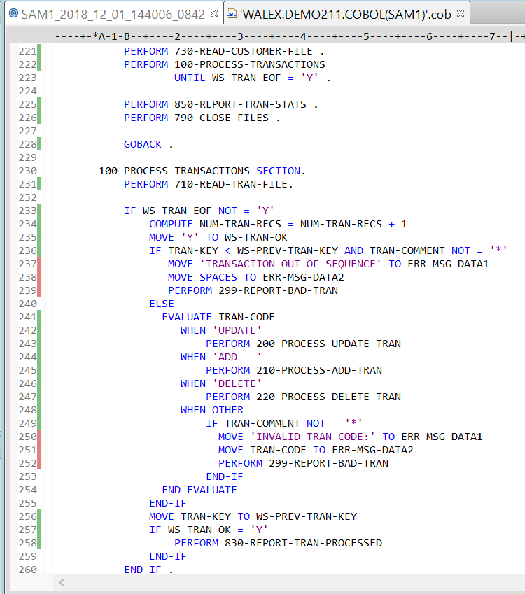
Test (code coverage)
Tracks lines of code that have been executed during test
Improves application testing quality
Focuses testing resource usage
Numerous reports and options to assess testing and trends
Source view
Summary
Comparisons
Merging
Supports: Batch, CICS and IMS
Integration with ADDI and SonarQube
Run in batch as part of your DevOps pipeline, with RESTful APIs for Debug profile creation
New! Web UI look and feel with easier filtering, grouping and comparisons, plus PDF output (14.1.5)
Compare results
Coverage
Notes:
And while the team is testing with the debugger enabled- either manually, automatically with Z Unit, or later in the cycle (for example integration testing), IDz offers the ability to collect code coverage information to assess test thoroughness.
Code coverage tracks the lines of code within a program that are executed.
For example, if you have a certain set of data drives certain logic, code coverage can show you that path, and then you can create new tests with new data to execute different paths within your application, and code coverage tracks this.
With 14.1.5, we changed the UI look and feel to be web-like, just as was done for program control flow. You can easily point and click from the report to see the actual lines of code that have been covered in the source.
Getting a handle on your level of code coverage is a recommended first step on the path to Continuous Integration, one of the recommended DevOps practices.

Slide 25
Z DevOps Pipeline
LEGEND
Eclipse, VS Code, Eclipse Che (BYOI) IBM Developer for z/OS Enterprise Edition (IDzEE)
IBM Wazi Workspaces (Code)
Dependency Base Build (IDzEE)
ZUnit (IDzEE)
IBM Wazi Virtual Test Platform
IBM Z Development and Test Enviroment (ZD&T)
IBM Wazi Workspaces (Sandbox)
IBM z/OS Cloudbroker
IBM Optim Test Data Managament
IBM Rational Test Workbench
Analyze
uBuild
Feedback, approvals
Note: Starting from the upper left, products and significant capabilities appear once, the first time they are used in the pipeline. Products and capabilities are used at multiple points.
https://galasa.dev/
+
Code
Build and Test
Provision
Deploy
Test
End to end DevOps The IBM way Open and Flexible
CI/CD Pipeline
Analyze
Plan
Monitor
Release
IBM Application
Discovery and Delivery
Intelligence
IBM Engineering Workflow Management
IBM Z APM Connect
OMEGAMON
Operational Insights
/ © 2020 IBM Corporation

Slide 26


Provisioning
Shift left with Z Development and Test Environment
Develop and test IBM Z applications anywhere, anytime with z/OS optimized for x86 hardware
zD&T tools to accelerate provisioning and image management
Cloud friendly, software-based licensing for enterprise customers (managed service on Softlayer)
Latest z/OS 2.3 software and middleware
Developer autonomy just like distributed, web and mobile developers!
Affordable off host development _{and test environment}
_{COBOL, PL/I, C++, Java,}
_{EGL, Batch, Assembler,}
z Systems Development and Test Environment (zD&T)
_{RTC}
_{IDz}
_{RIT}
_{UCD}
_{DT}
_{IMS}
_{CICS}
_{DB2}
_{WAS}
_{MQ}
_{z/OS}
_{zD&T}
_{X86 PC or HX5 Blade} _{running Linux}
_{IBM Cloud Infrastructure}
26
Notes:
zD&T provides a z/OS environment, on the developers desktop, or laptop, to make it easy for developers to test their changes without impacting other developers. It is easy to provision, which motivates developers to test early, and test often. <AHL: Need to highlight the new provisioning and image management capabilities in zD&T. In fact, for all of these sections, we need a "new news" slide or call that out on the slide with the prose.>
26

Slide 27











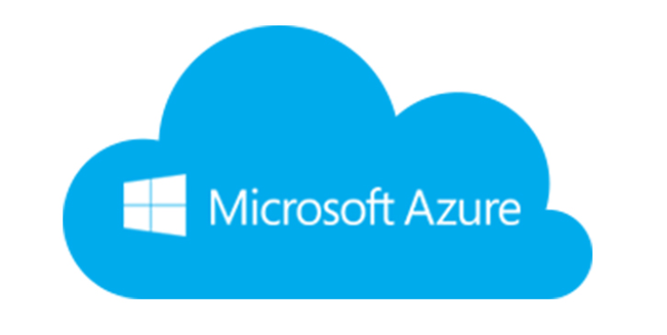
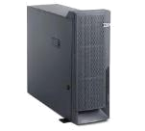
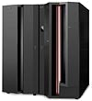
UrbanCode for Deployment automation (UCD)
From mainframe to i-series to distributed to cloud-native
Mobile Device
Develop
SCM
Build
IBM UrbanCode Deploy
Cloud: Public / Private / Hybrid
IDE
CI Tool
App
IBM UrbanCode Deploy automates the deployment of applications, databases and configurations into development, test and production environments, helping to drive down cost, speed time to market with reduced risk.
Deployment orchestration for Distributed and z/OS Applications – including CICS, Db2, MQ, across multiple environments
Integrates with Jenkins
Manages artifact versions via an in-built repository called codestation
Traditional
Mainframe

Slide 28
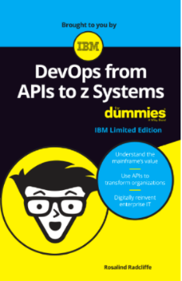
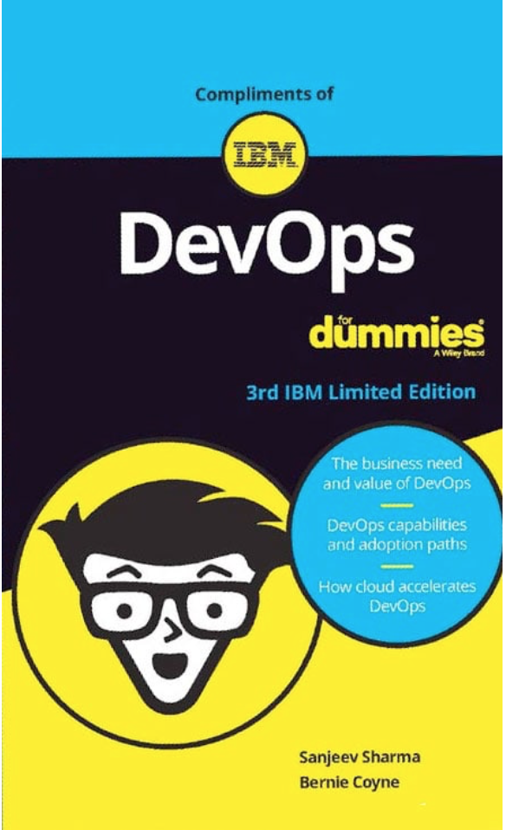
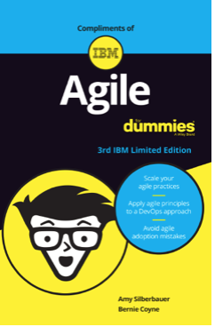

Additional Resources
Mainframe CI/CD with an open toolchain:
https://www.linkedin.com/pulse/mainframe-cicd-open-toolchain-its-real-spectacular-minaz-merali/
Mainframe Dev Center:
https://developer.ibm.com/mainframe/
IBM DevOps for Enterprise Systems:
https://www.ibm.com/it-infrastructure/z/capabilities/enterprise-devops
For Dummies books:
https://www.ibm.com/ibm/devops/us/en/resources/dummiesbooks/
IBM Z Trial:
https://ibm.biz/z-trial
28
© Copyright IBM Corporation 2019

Slide 29

Notes:
You can use this chart to show that the formal presentation is finished and to open up a Question and Answer session.

Slide 30

Agenda - Day 1
10:00 Introduction to DevOps on IBM Z - focus on open source tools (Ron)
10:40 LAB 1 - Working with z/OS using COBOL and DB2 or LAB7 - IBM DBB with Git, Jenkins and UCD on Z
12:50 Checkpoint - Comments and Closing Day 1 (Ron/Wilbert/Regi)
10:00 zUnit and Wazi VTP Overview (Wilbert)
10:15 Demo: Scenario using Z DevOps solutions including zUnit, Git and Jenkins (Regi)
11:00 – 12:50 Choose one Optional lab:
→ LAB 7 - IBM DBB with Git, Jenkins and UCD on Z (1 hour)
→ LAB 6B : Using IBM zUnit to Unit Test a COBOL CICS application (1 hour) → LAB 2D: z/OS Connect EE toolkit – Create/deploy Service and API for Catalog Manager App → LAB 5: UCD – Create UrbanCode Deploy infrastructure and deploy to z/OS → LAB 8 - Using Application Performance Analyzer (APA)
12:50 Checkpoint - Comments and Closing Day 2 (Ron/Wilbert/Regi)
Agenda - Day 2
Lecture
Labs

Slide 31
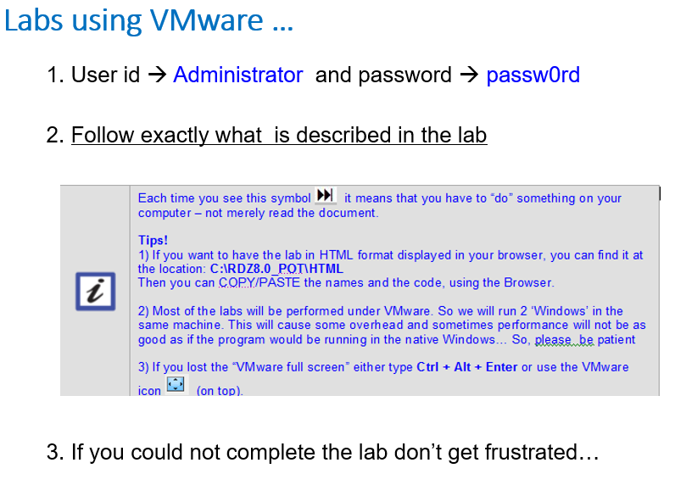

DevOps Mainframe Tooling - Labs
Labs
empot01

Slide 32


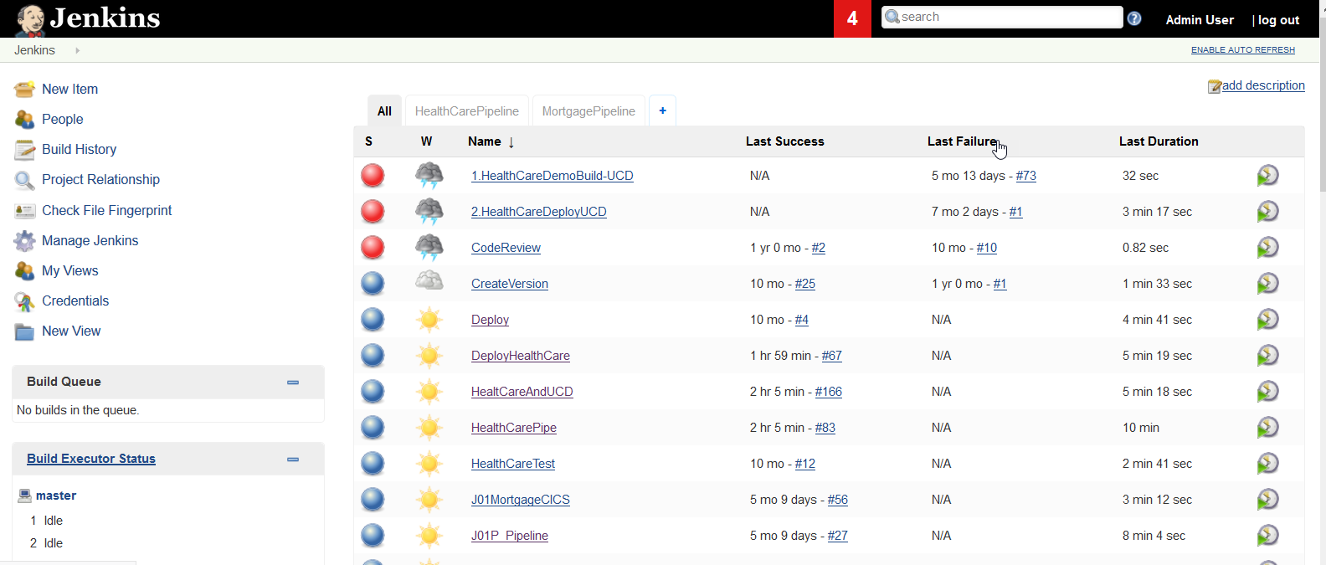
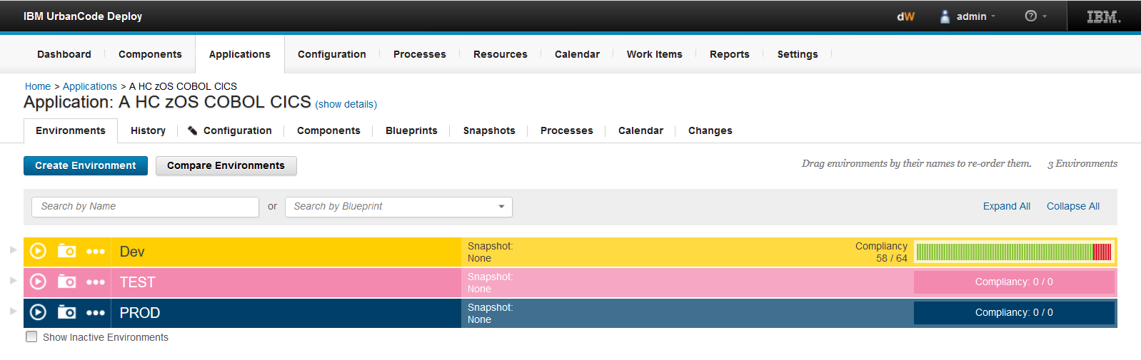

zD&T on Cloud environment
zD&T
z/OS
Linux
DBB
Jenkins Agent
Windows
UCD-Agent
Developer using ADFz
DBB
App server
Git
Source
Code
Git
Jenkins
UCD Server
Executables

Slide 33
Lab 1: Working with mainframe using COBOL and DB2
Duration: 90 Minutes
Objective
This lab will take you through the steps of using the Application Delivery Foundation for z Systems (ADFz) to work with a z/OS system. It will familiarize you with some of the capabilities of this product using a DB2 COBOL batch program that is ABENDing.
Key Activities
Connect to a z/OS System. Use your Workspace to connect to the z/OS system. Each student will have an unique z/OS userid.
Execute the DB2/COBOL batch program and verify the ABEND.
Use Fault Analyzer to identify the cause of the ABEND
Use the IBM Debug for a temporary fix
You will modify the field content to bypass the bug
Modify the COBOL code to fix the bug.
Use Code Coverage
(Optional) Execute SQL statement when editing the program.
While editing the COBOL/DB2 program you will be able to execute SQL statements and verify the results.
(Optional) Using File Manager An example of using File Manager against a VSAM file

Slide 34
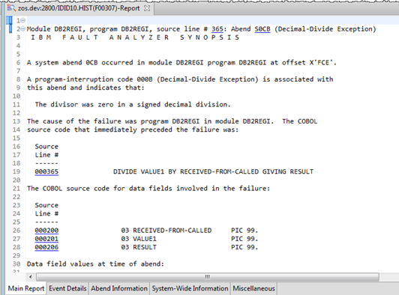
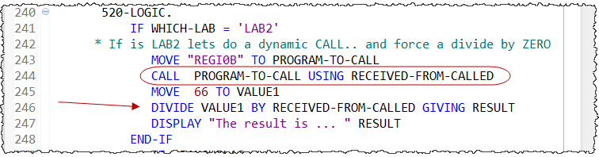
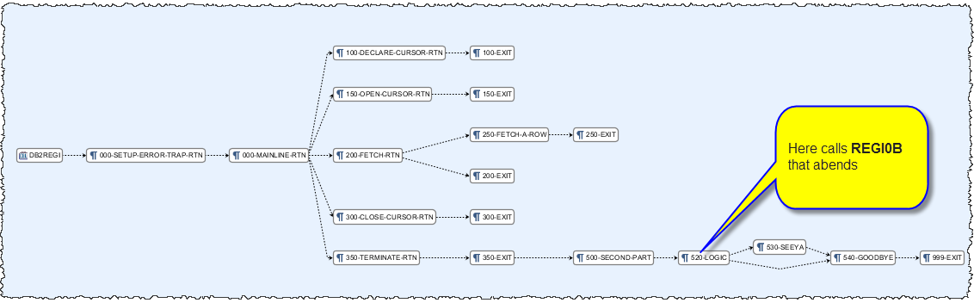
Lab 1: Working with mainframe using COBOL and DB2

Slide 35
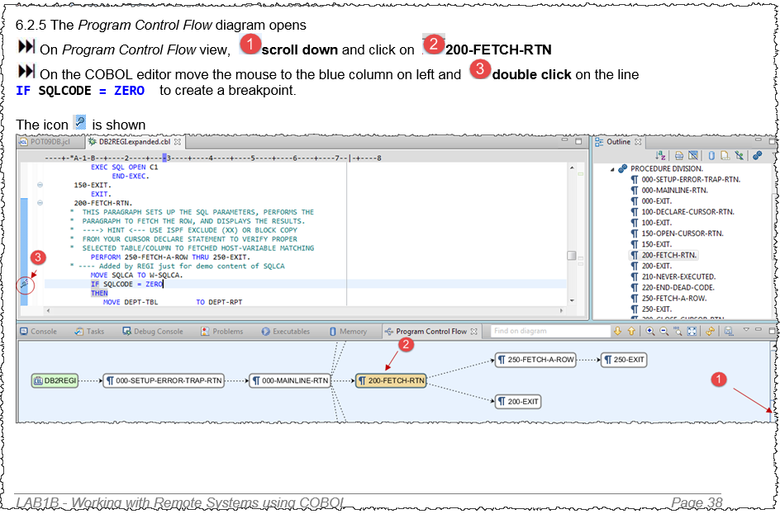
Lab 1: Don’t Miss… The Debug… Page 22

Slide 36
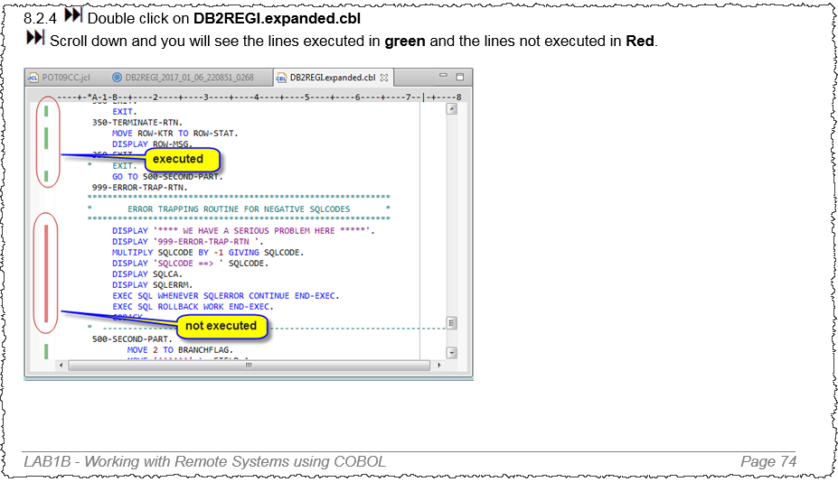
Lab 1: Don’t Miss… Code Coverage …Page 48

Slide 37
Lab 7: Using IBM Dependency Based Build with Git, Jenkins and UCD on z/OS
This lab will use IBM Dependency Based Build (DBB) along with Git, Jenkins and UrbanCode Deploy (UCD) on z/OS. You will modify an existing COBOL/CICS application stored on Git. You will use ADFz to change the code and perform a personal test for later delivery and commit to Git and then use Jenkins for the final build and continuous delivery. The updated code will be deployed to CICS using UrbanCode Deploy (UCD) .
Overview of development tasks
Get familiar with the application using the 3270 terminal → You will start a 3270 emulation and execute a transaction named JxxP to become familiar with the Application that you intend to modify.
Load the source code from Git to the local IDz workspace → You will load the COBOL code that is stored on Linux to your windows client to be modified.
Modify the COBOL code using IDz. → Using IDz you will modify the COBOL code to have a different message in a CICS dialog.
Use IDz DBB User Build to compile/bind and perform personal tests. → You will compile and link the modified code using the DBB User Build function available on IDz EE or ADFz. When complete you will run the code using CICS for a personal test and verify that the change is correctly implemented.
Push and Commit the changed code to Git . → You will commit the changes to Git.
Use Jenkins with Git plugin to build the modified code → You will use Jenkins pipeline to build the new changed code and push the executables to be deployed using UCD.
Use Jenkins and UCD plugin to deploy results and test the code again → You will verify the results after the final deploy to CICS using UCD
8. (Optional) Understanding DBB Build Reports → You will understand the reports generated by DBB during the build

Slide 38
Agenda - Day 1
10:00 Introduction to DevOps on IBM Z - focus on open source tools (Ron)
10:40 LAB 1 - Working with z/OS using COBOL and DB2 or LAB7 - IBM DBB with Git, Jenkins and UCD on Z
12:50 Checkpoint - Comments and Closing Day 1 (Ron/Wilbert/Regi)
10:00 zUnit and Wazi VTP Overview (Wilbert)
10:15 Demo: Scenario using Z DevOps solutions including zUnit, Git and Jenkins (Regi)
11:00 – 12:50 Choose one Optional lab:
→ LAB 7 - IBM DBB with Git, Jenkins and UCD on Z (1 hour)
→ LAB 6B : Using IBM zUnit to Unit Test a COBOL CICS application (1 hour) → LAB 2D: z/OS Connect EE toolkit – Create/deploy Service and API for Catalog Manager App → LAB 5: UCD – Create UrbanCode Deploy infrastructure and deploy to z/OS → LAB 8 - Using Application Performance Analyzer (APA)
12:50 Checkpoint - Comments and Closing Day 2 (Ron/Wilbert/Regi)
Agenda - Day 2
Lecture
Labs

Slide 39
Agenda - Day 1
10:00 Introduction to DevOps on IBM Z - focus on open source tools (Ron)
10:40 LAB 1 - Working with z/OS using COBOL and DB2 or LAB7 - IBM DBB with Git, Jenkins and UCD on Z
12:50 Checkpoint - Comments and Closing Day 1 (Ron/Wilbert/Regi)
10:00 zUnit and Wazi VTP Overview (Wilbert)
10:15 Demo: Scenario using Z DevOps solutions including zUnit, Git and Jenkins (Regi)
11:00 – 12:50 Choose one Optional lab:
→ LAB 7 - IBM DBB with Git, Jenkins and UCD on Z (1 hour)
→ LAB 6B : Using IBM zUnit to Unit Test a COBOL CICS application (1 hour) → LAB 2D: z/OS Connect EE toolkit – Create/deploy Service and API for Catalog Manager App → LAB 5: UCD – Create UrbanCode Deploy infrastructure and deploy to z/OS → LAB 8 - Using Application Performance Analyzer (APA)
12:50 Checkpoint - Comments and Closing Day 2 (Ron/Wilbert/Regi)
Agenda - Day 2
Lecture
Labs

Slide 40
Z DevOps Pipeline
LEGEND
Eclipse, VS Code, Eclipse Che (BYOI) IBM Developer for z/OS Enterprise Edition (IDzEE)
IBM Wazi Workspaces (Code)
Dependency Base Build (IDzEE)
ZUnit (IDzEE)
IBM Wazi Virtual Test Platform
IBM Z Development and Test Enviroment (ZD&T)
IBM Wazi Workspaces (Sandbox)
IBM z/OS Cloudbroker
IBM Optim Test Data Managament
IBM Rational Test Workbench
Analyze
uBuild
Feedback, approvals
Note: Starting from the upper left, products and significant capabilities appear once, the first time they are used in the pipeline. Products and capabilities are used at multiple points.
https://galasa.dev/
+
Code
Build and Test
Provision
Deploy
Test
End to end DevOps The IBM way Open and Flexible
CI/CD Pipeline
Analyze
Plan
Monitor
Release
IBM Application
Discovery and Delivery
Intelligence
IBM Engineering Workflow Management
IBM Z APM Connect
OMEGAMON
Operational Insights
/ © 2020 IBM Corporation

Slide 41


Shift Left testing
Start your testing here
Don’t wait until here
Source Code Management (SCM)
Development
Build
Deployment
Integration testing
Test Fails
Deb, The Developer
Checks in code
Runs build
Deploys changes to the target environment
Full integration test
Makes a code change for program HCMADB02 as part of transaction HCAZ
Shift Left
IBMZ / IBM Wazi Virtual Test Platform Client Presentation / June 2020 / © 2020 IBM Corporation
Notes:
Before we get into details of what we mean by shift left, it is important to understand that shift left testing does not replace higher level of testing which are still required to ensure software quality.
In this example, Deb the developers is making a code change, checks in the code, runs the build and deploys the artifacts to the next target system. Finally at this stage, the tests are executed and its fails. Now, there are several questions and uncertainties which arise. Did the test fail due to the code change or the environment at which it was tested or was someone else making change to the same program and so on.
So how do we solve this problem ? Shift Left! Start testing as early as code phase, automate the tests and reduce environment dependency.

Slide 42
The Testing Pyramid
What tools and practice do IBM offer to fit in with The Test Pyramid?
User Acceptance Test
Actual users test the software to ensure the change meets business requirement
User Acceptance
System
System Test
Post-Deployment
RTW (Rational Integration Tester/Rational functional tester/Test Virtualization Server)
Application Integration
Pre-Deployment
Unit test
Application Integration test IBM Wazi Virtual Test Platform
Unit
Unit test
ZUnit (IBM Developer for z/OS)
42
IBM Z Testing Strategy Sales Presentation / July 2020 / © 2020 IBM Corporation
Notes:
The first stage of shift left testing is the ability to test the unit of code. When Deb makes a change to a program, she can immediately test the code at program level. This is unit testing feature is part of our ZUnit offering, currently available with IBM Developer for z/OS.
With ZUnit, Deb has tested the code at program level reducing the possibility of this change resulting in a defect when tested later in the development cycle. Deb will now deploy the changed artifacts with more confidence into target systems. The next step is to test the complete transaction associated with the program to ensure that the change has not impacted the larger transaction. Currently this is done as part of Integration tests after deployment stage running against original middleware and subsystems.
We are changing this and for the first time in IBM Z, we are shifting application integration testing left!. As highlighted in the pyramid, post deployment testing such as service test and end-to-end test continuously play a key role in ensuring software quality.
Note: nowhere do we see mention of manual testing ☺ don’t rely too heavily on manual intervention or you’ll end up with the testing ice-cream cone.

Slide 43
Unit Testing (zUnit)
Scope - Program
Transaction - HCAZ
A
B
C
D
E
A unit is the smallest testable part of software – meaning testing an individual unit of source code, like a single source file which contains a list of methods, procedures.
Our current “unit” for z/OS Applications is a Program

Slide 44
Shift Left – unit testing with ZUnit
A way of testing the smallest piece of code or program that can be practically isolated
This is done at the program level
Stub
Database
IBMZ / IBM Wazi Virtual Test Platform Client Presentation / June 2020 / © 2020 IBM Corporation
Notes:
Shift Left! As discussed earlier, performing the testing earlier in the development cycle is key to ensuring increased speed to market and software quality.
Our existing ZUnit solution available as part of IBM Developer for z/OS enables developers to easily generate and execute unit tests for z/OS programs. This testing is done at program level enabling shift left testing.

Slide 45

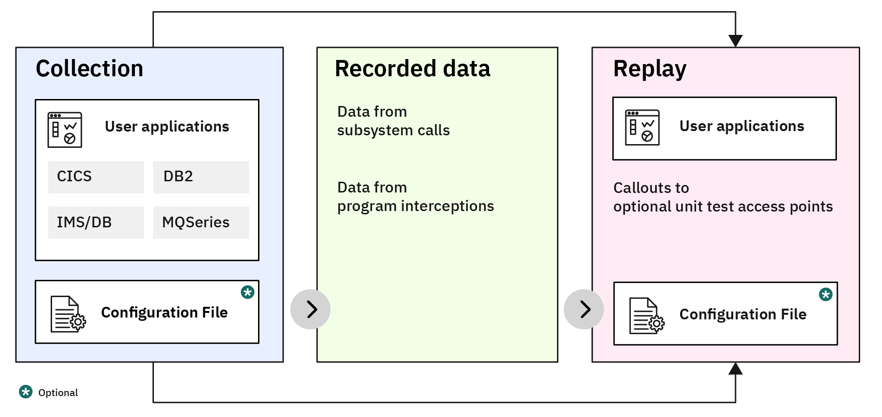
ZUnit High Level Architecture
IDz
Invokes the testcase editor for a program
CICS
IDz Record/Import service
Dynamic Test Runner CICS API
User Applications
Files
Dynamic Test Runner:
Collection
START/STOP RECORD
Db2
Generates the testcase artifacts
zUnit Testcase
Batch Recording
Dynamic Test Runner:
Collection
RECORD
User Applications
Files
Db2
Descriptor
Playback file
User Applications
Testcase program
Run Config
Dynamic Test Runner:
Replay
Testcase Results
Testcase binaries
z/os
Stored in SCM

Slide 46
zUnit Basic Workflow
1
2
3
4
5
6
Generate Test Case Wizard
Test Data Entry Editor
Generate Test Case Program
Build Test Case
Run Test
Examine Test Results

Slide 47
Application Integration test (Wazi VTP)
Scope - Transaction
Transaction - HCAZ
A
B
C
D
E
Application integration test is the next level of testing after Unit Testing. Its purpose is to confirm that the changes in a unit (programs) works with the interfaces to other units (programs), and ensure no unexpected impacts to other units
Transaction and batch jobs

Slide 48
Testing with Wazi Virtual Test Platform
Part 1 – Capture or Collection
Part 2 – Replay
Collection/Capture
Recorded Data
Replay
User applications
User applications
CICS
Db2
Data from
subsystem calls
Callouts to
optional access points
IMS/DB
IBM MQ
Data from
program interception
Configuration File
Configuration File
Notes:
Here is a high level overview of the simplified Wazi Virtual Test Platform architecture. The product has three key components, collection, playback file and a replay. You also see a configuration file in there. The configuration file is used to identify any optional program-to-program interceptions.
The collection or the recording is done on a real LPAR where the middleware, subsystem and data resides. For example, to record a CICS transaction, you login to CICS, start the recording, execute the transaction and stop the recording. Wazi Virtual Test Platform intercepts and records a variety of subsystem and program-to-program calls as part of this collection process. There is no need to change any code in the program and nothing additional is included. There is no need for recompilation, relinking or rebinding. Additionally, there is no requirement for a debugger to be used for this process. All the interceptions are performed using the user’s original load modules, whether the application runs in CICS, IMS, Db2 or batch. The process would then create the recorded data which is stored in what we call a playback file. The recorded data or a playback file is a flat file in Z. This file then becomes the input to executing the test, presented as replay in the architecture. The Platform provides the capability to execute these tests using playback file as its input without the need for original middleware or data.
You also have the flexibility to run these tests on a thin Z Development and Test (ZD&T) environment. All you need is a z/OS environment, the load modules you want to run, and the data file.

Slide 49

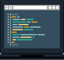
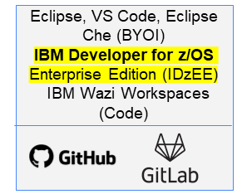

The Testing Pipeline
IBM Infosphere Optim products
Test Data
Optim Test data Management
Optim Test data fabrication
Other Optim products
Prod/Prod-Clone
Pre deployment
Post deployment
IDz(Zunit)
Wazi VTP
Rational Test WorkBench (RTW)
( RPT, RFT and RIT)
Rational Test Virtualization Server
End user test
Unit Testing
Application Integration Test
(Isolated integration test)
Lpar with deployed App
User Acceptance Test
System test
Code
Build and Test
Provision
Deploy
Test
Test
Code Change
Personal build
Unit test with ZUnit
Pipeline Build
Unit testing with ZUnit
Appl Int Test with VTP
Build and Execute Functional Tests
Build and Execute Performance Tests
Build and Execute Integration Tests
Review and manage test reports
End user test

Slide 50
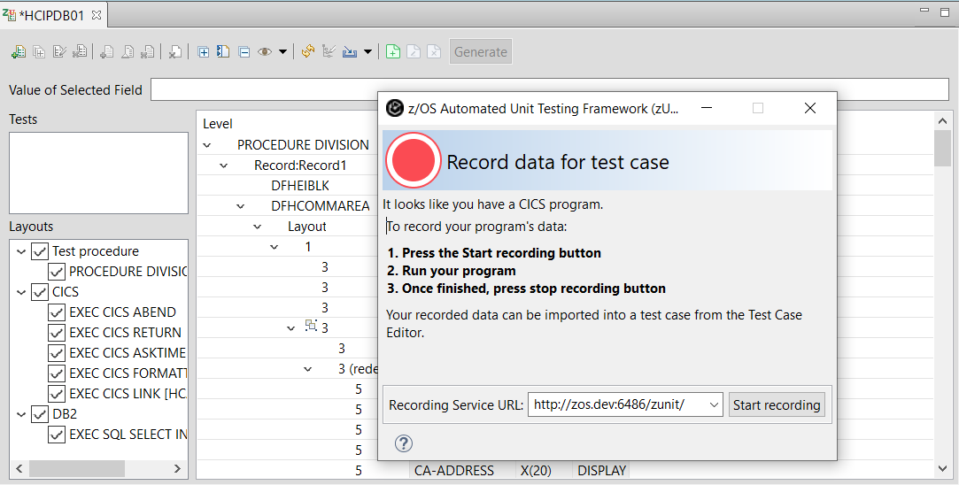
IBM zUnit for CICS/DB2 programs
Start Recording
Execute the program in CICS
Stop Recording
Import recorded data in Test Case
Generate Test Case
Build Test Case
Run Test Case
Outside of CICS

Slide 51
Agenda - Day 1
10:00 Introduction to DevOps on IBM Z - focus on open source tools (Ron)
10:40 LAB 1 - Working with z/OS using COBOL and DB2 or LAB7 - IBM DBB with Git, Jenkins and UCD on Z
12:50 Checkpoint - Comments and Closing Day 1 (Ron/Wilbert/Regi)
10:00 zUnit and Wazi VTP Overview (Wilbert)
10:15 Demo: Scenario using Z DevOps solutions including zUnit, Git and Jenkins (Regi)
11:00 – 12:50 Choose one Optional lab:
→ LAB 7 - IBM DBB with Git, Jenkins and UCD on Z (1 hour)
→ LAB 6B : Using IBM zUnit to Unit Test a COBOL CICS application (1 hour) → LAB 2D: z/OS Connect EE toolkit – Create/deploy Service and API for Catalog Manager App → LAB 5: UCD – Create UrbanCode Deploy infrastructure and deploy to z/OS → LAB 8 - Using Application Performance Analyzer (APA)
12:50 Checkpoint - Comments and Closing Day 2 (Ron/Wilbert/Regi)
Agenda - Day 2
Lecture
Labs

Slide 52

LEGEND
Eclipse, VS Code, Eclipse Che (BYOI) IBM Developer for z/OS Enterprise Edition (IDzEE)
IBM Wazi Workspaces (Code)
Dependency Based Build (IDzEE)
ZUnit (IDzEE)
IBM Wazi Virtual Test Platform
IBM Z Development and Test Enviroment (ZD&T)
IBM Wazi Workspaces (Sandbox)
IBM z/OS Cloudbroker
IBM Optim Test Data Managament
IBM Rational Test Workbench
Analyze
Feedback, approvals
uBuild
Note: Starting from the upper left, products and significant capabilities appear once, the first time they are used in the pipeline. Products and capabilities are used at multiple points.
https://galasa.dev/
+
Code
Build and Test
Provision
Deploy
Test
End to end DevOps The IBM way Open and Flexible
CI/CD Pipeline
Nexus
Analyze
Plan
Monitor
Release
IBM Application
Discovery and Delivery
Intelligence
IBM Engineering Workflow Management
IBM Z APM Connect
OMEGAMON
Operational Insights

Slide 53

Topology used on this Demo
zD&T on VMWARE
z/OS
Linux
DBB
Source
Code
Jenkins Agent
UCD-Agent
Windows
Developer using ADFz
DBB
App server
Git
Jenkins
UCD Server
Executables
© Copyright IBM Corporation 2020

Slide 54
Z DevOps Tooling Demonstration COBOL/CICS/DB2 Program
Demonstration
PART 1 - Z Unit Test using IDz (zUnit)
Notes:
This session of a “DevOps for Dummies” overview will help you understand DevOps as it applies to Enterprise Systems and why it is so critical in today’s multi-platform, multi-channel world. Don’t expect to leave with a complete and thorough understanding, but enough to allow you to talk intelligently about what DevOps and its related “buzz words” mean with your colleagues. You will also get a sense of where your organization might need to get started on it’s path toward DevOps Adoption. And… you’ll have some good next steps.

Slide 55



Scenario: COBOL CICS/DB2 Transaction
Using transaction HCAZ option 2 (Inquire Patient) and Patient ID 1 press PF12 Run second test case using Patient ID 2 Patient information is displayed by program HCIPDB01
➔ Developer A will work on this program and introduce a bug

Slide 56










Scenario: COBOL CICS/DB2 Transaction using z/OS Connect
Invoking the z/OS Connect Restful API service inquirepatient and patNum 1 Run second test case using patNum 2 Patient information is displayed by z/OS Connect using program HCIPDB01
➔ Developer A will work on this program and introduce a bug
© Copyright IBM Corporation 2020

Slide 57

PART #1 – Unit test on COBOL/CICS program HCIPDB01
Load the COBOL code from Git (GitHub)
Before any change, developer records CICS program interactions using IDz
Generate, build and run the zUnit test Compile and link-edit the generated unit test programs using IBM DBB, followed by running the unit test.
Modify the program and rerun the zUnit test Modify the program under test and introduce a bug (bad name for Patient ID #1, Rerun the unit test, and observe the failure of the test case. All done in batch.. No need to start CICS.. No need of DB2
© Copyright IBM Corporation 2020

Slide 58


1. Load the COBOL code from Git (GitHub)
https://github.com/RegiBrazil/DemoHealthCare/tree/sandbox/DemoHealthCare

Slide 59
PART #1 – Unit test on COBOL/CICS program HCIPDB01
Load the COBOL code from Git (GitHub)
Before any change, developer records CICS program interactions using IDz
Generate, build and run the zUnit test Compile and link-edit the generated unit test programs using IBM DBB, followed by running the unit test.
Modify the program and rerun the zUnit test Modify the program under test and introduce a bug (bad name for Patient ID #1, Rerun the unit test, and observe the failure of the test case. All done in batch.. No need to start CICS.. No need of DB2
© Copyright IBM Corporation 2020

Slide 60




2. Record CICS program interaction using IDz …
Using sandbox branch

Slide 61







2. Record CICS program interaction using IDz
© Copyright IBM Corporation 2020

Slide 62






2. Record CICS program interaction using IDz …

Slide 63
PART #1 – Unit test on COBOL/CICS program HCIPDB01
Load the COBOL code from Git (GitHub)
Before any change, developer records CICS program interactions using IDz
Generate, build and run the zUnit test Compile and link-edit the generated unit test programs using IBM DBB, followed by running the unit test.
Modify the program and rerun the zUnit test Modify the program under test and introduce a bug (bad name for Patient ID #1, Rerun the unit test, and observe the failure of the test case. All done in batch.. No need to start CICS.. No need of DB2
© Copyright IBM Corporation 2020

Slide 64





3. Generate, build and run the unit test..
© Copyright IBM Corporation 2020

Slide 65




3. Generate, build and run the unit test…
© Copyright IBM Corporation 2020

Slide 66





3. Generate, build and run the unit test
© Copyright IBM Corporation 2020

Slide 67
PART #1 – Unit test on COBOL/CICS program HCIPDB01
Load the COBOL code from Git (GitHub)
Before any change, developer record CICS program interactions using IDz.
Generate, build and run the zUnit test Compile and link-edit the generated unit test programs using IBM DBB, followed by running the unit test.
Modify the program and rerun the zUnit test Modify the program under test and introduce a bug (bad name for Patient ID #1, Rerun the unit test, and observe the failure of the test case. All done in batch.. No need to start CICS. No need of DB2..
© Copyright IBM Corporation 2020

Slide 68



4. Modify the program and rerun the unit test (with code coverage)…
Using \DemoHealthCare\zAppBuild\build_zUnit_CC_DB01.groovy
© Copyright IBM Corporation 2020

Slide 69




4. Modify the program and rerun the unit test
OR
© Copyright IBM Corporation 2020

Slide 70

PART #1 – Unit test on COBOL/CICS program HCIPDB01
Load the COBOL code from Git (GitHub)
Before any change, developer records CICS program interactions using IDz.
Generate, build and run the zUnit test Compile and link-edit the generated unit test programs using IBM DBB, followed by running the unit test.
Modify the program and rerun the zUnit test Modify the program under test and introduce a bug (bad name for Patient ID #1, Rerun the unit test, and observe the failure of the test case. All done in batch.. No need to start CICS. No need of DB2..
Developer A is frustrated.. and go home..
© Copyright IBM Corporation 2020

Slide 71
DevOps Mainframe Tooling Demonstration CICS/DB2 COBOL Program
Demonstration
Part 2 - Git/DBB/Jenkins/UCD
© Copyright IBM Corporation 2020

Slide 72

Scenario: Developer will use DBB to fix the bug
Bug was created by developer A.
© Copyright IBM Corporation 2020

Slide 73
PART #2 – Fix COBOL/CICS HCIPDB01 broken program
Developer B will fix the issue created by developer A
Developer B run the zUnit test case and verify the bug. Optionally he could use the Debug (in BATCH) to see the “bug
Uses IDz to update the COBOL program
Uses DBB to perform a “User Build”, run the unit test (zUnit), Code Coverage and verify that the program is fixed
Optionally change zUnit test case for better Code Coverage
Commit and Push the corrected code to Git (GitHub)
© Copyright IBM Corporation 2020

Slide 74


1. Developer B run the zUnit test case and verify the bug…
OR
© Copyright IBM Corporation 2020

Slide 75


1. Developer B run the zUnit test case and verify the bug..
It could use the Debug (in BATCH) to see the “bug”
All done in batch.. No need to start CICS. No need of DB2..
© Copyright IBM Corporation 2020

Slide 76
PART #2 – Fix COBOL/CICS HCIPDB01 broken program
Developer B will fix the issue created by developer A
Developer B run the zUnit test case and verify the bug. Optionally he could use the Debug (in BATCH) to see the “bug
Uses IDz to update the COBOL program
Uses DBB to perform a “User Build”, run the unit test (zUnit), Code Coverage and verify that the program is fixed
Optionally change zUnit test case for better Code Coverage
Commit and Push the corrected code to Git (GitHub)
© Copyright IBM Corporation 2020

Slide 77




2. Uses IDz to update the COBOL program using local copy
© Copyright IBM Corporation 2020

Slide 78
PART #2 – Fix COBOL/CICS HCIPDB01 broken program
Developer B will fix the issue created by developer A
Developer B run the zUnit test case and verify the bug. Optionally he could use the Debug (in BATCH) to see the “bug
Uses IDz to update the COBOL program
Uses DBB to perform a “User Build”, run the unit test (zUnit), Code Coverage and verify that the program is fixed
Optionally change zUnit test case for better Code Coverage
Commit and Push the corrected code to Git (GitHub)
© Copyright IBM Corporation 2020

Slide 79





3. Uses DBB to perform a “User Build”, run the Unit Test (zUnit), Code Coverage and verify that the abend is fixed
Uses \DemoHealthCare\zAppBuild\build_zUnit_CC_DB01.groovy
© Copyright IBM Corporation 2020

Slide 80








3. Uses DBB to perform a “User Build”, run the Unit Test (zUnit), Code Coverage and verify that the abend is fixed
© Copyright IBM Corporation 2020

Slide 81

3. Uses DBB to perform a “User Build”, run the Unit Test (zUnit), Code Coverage and verify that the abend is fixed
© Copyright IBM Corporation 2020

Slide 82
PART #2 – Fix COBOL/CICS HCIPDB01 broken program
Developer B will fix the issue created by developer A
Developer B run the zUnit test case and verify the bug. Optionally he could use the Debug (in BATCH) to see the “bug
Uses IDz to update the COBOL program
Uses DBB to perform a “User Build”, run the unit test (zUnit), Code Coverage and verify that the program is fixed
Optionally change zUnit test case for better Code Coverage
Commit and Push the corrected code to Git (GitHub)
© Copyright IBM Corporation 2020

Slide 83









4. Optionally change zUnit test case for better Code Coverage…
Could find “bugs” not ever tested before… (shift to the left)
SQLCODE -913 must have 90 at CA-RETURN-CODE
This condition is not tested
© Copyright IBM Corporation 2020
© Copyright IBM Corporation 2020

Slide 84





4. Optionally change zUnit test case for better Code Coverage…
© Copyright IBM Corporation 2020

Slide 85



4. Optionally change zUnit test case for better Code Coverage
SQLCODE -913 must have 90 at CA-RETURN-CODE
© Copyright IBM Corporation 2020

Slide 86
PART #2 – Fix COBOL/CICS HCIPDB01 broken program
Developer B will fix the issue created by developer A
Developer B run the zUnit test case and verify the bug. Optionally he could use the Debug (in BATCH) to see the “bug
Uses IDz to update the COBOL program
Uses DBB to perform a “User Dependency Build”, run the Unit Test (zUnit), Code Coverage and verify that the program is fixed
Optionally change zUnit test case for better Code Coverage
Commit and Push the corrected code to Git (GitHub)
© Copyright IBM Corporation 2020

Slide 87



5. Commit and Push the corrected code to Git (GitHub)
© Copyright IBM Corporation 2020

Slide 88
PART #3 - Release Engineer Deploy to z/OS and Mobile.
Rebecca – Release Engineer Executes the Team Building using Jenkins
Uses Jenkins to perform the “team” building and UrbanCode Deploy (UCD) to deploy.
Verify the Build results using DBB browser
Verify the Deploy results using UCD browser
Run the new deployed CICS application
© Copyright IBM Corporation 2020

Slide 89

Example Pipeline Results

Slide 90


High Level Demo Diagram using Jenkins-Git-DBB-UCD(UrbanCode Deploy)
[1] Jenkins server sends build commands to zOS remote agent.
[2] Jenkins agent issues Git pull command to update zOS Rocket Git repository (get latest updates).
[3] zOS Rocket’s Git client automatically converts source from UTF-8 to EBCDIC during pull.
[4] Jenkins agent invokes build scripts containing DBB APIs using zOS Git repository (Rocket).
[5] DBB Toolkit provides Java APIs to:
[5a] Create datasets, copy source from zFS to PDS, invoke zOS Compiler/Linkage Editor.
[5b] DBB scan and store dependency data from source files, perform dependency and impact analysis, store build results on DBB WebApp .
[5c] Copy logs from PDS to zFS, generate build reports (can be saved in build result).
[5d] Invoke UCD toolkit to create a deployable version at UCD Server (Linux)
X86 (Linux)
UCD Server
DBB WebApp
3
5b
1
z/OS
UCD Toolkit
5d
DBB Toolkit
2
(Agent)
5a
5
3
UNIX file system
PDS
Source Code
Build Scripts
4
5c
© Copyright IBM Corporation 2020

Slide 91









UrbanCode Deploy for Deployment Automation
Deploying to Mainframe
Develop
SCM
Build
IBM UrbanCode Deploy
IDE or TSO/ISPF
z/OS
LPAR
From Source Code, Using JCL: Compile, Link and Bind
LOADLIB + DBRM
z/OS
LPAR
z/OS
LPAR
UCD
Agent
UCD
Agent
UCD
Agent
* RTC → IBM® Engineering Workflow Management
Mainframe

Slide 92
PART #3 - Release Engineer Deploy to z/OS and Mobile.
Rebecca – Release Engineer Executes the Team Building using Jenkins
Uses Jenkins to perform the “team” building and UrbanCode Deploy (UCD) to deploy.
Verify the Build results using DBB browser
Verify the Deploy results using UCD browser
Run the new deployed CICS application
© Copyright IBM Corporation 2020

Slide 93











Demo High Level Diagram using Jenkins-Git-DBB-UCD
* UCD = UrbanCode Deploy

Slide 94
PART #3 - Release Engineer Deploy to z/OS and Mobile.
Rebecca – Release Engineer Executes the Team Building using Jenkins
Uses Jenkins to perform the “team” building and UrbanCode Deploy (UCD) to deploy.
Verify the Build results using DBB browser
Verify the Deploy results using UCD browser
Run the new deployed CICS application
© Copyright IBM Corporation 2020

Slide 95



Verify the Build results using DBB browser

Slide 96
PART #3 - Release Engineer Deploy to z/OS and Mobile.
Rebecca – Release Engineer Executes the Team Building using Jenkins
Uses Jenkins to perform the “team” building and UrbanCode Deploy (UCD) to Deploy.
Verify the Build results using DBB browser
Verify the Deploy results using UCD browser
Run the new deployed CICS application
© Copyright IBM Corporation 2020

Slide 97

Verify the Deploy results using UCD browser

Slide 98
PART #3 - Release Engineer Deploy to z/OS and Mobile.
Rebecca – Release Engineer Executes the Team Building using Jenkins
Uses Jenkins to perform the “team” building and UrbanCode Deploy (UCD) to deploy.
Verify the Build results using DBB browser
Verify the Deploy results using UCD browser
Run the new deployed CICS application
© Copyright IBM Corporation 2020

Slide 99


Run the new deployed CICS application

Slide 100
DevOps Mainframe Tooling Demonstration CICS/DB2 COBOL Program
Demonstration
Part 3 - Deploy using /Jenkins/UCD
Notes:
This session of a “DevOps for Dummies” overview will help you understand DevOps as it applies to Enterprise Systems and why it is so critical in today’s multi-platform, multi-channel world. Don’t expect to leave with a complete and thorough understanding, but enough to allow you to talk intelligently about what DevOps and its related “buzz words” mean with your colleagues. You will also get a sense of where your organization might need to get started on it’s path toward DevOps Adoption. And… you’ll have some good next steps.

Slide 101
Agenda - Day 1
10:00 Introduction to DevOps on IBM Z - focus on open source tools (Ron)
10:40 LAB 1 - Working with z/OS using COBOL and DB2 or LAB7 - IBM DBB with Git, Jenkins and UCD on Z
12:50 Checkpoint - Comments and Closing Day 1 (i)
10:00 zUnit and Wazi VTP Overview (Wilbert)
10:15 Demo: Scenario using Z DevOps solutions including zUnit, Git and Jenkins (Regi)
11:00 – 12:50 Choose one Optional lab: (Tim)
→ LAB 7 - IBM DBB with Git, Jenkins and UCD on Z (1 hour)
→ LAB 6B : Using IBM zUnit to Unit Test a COBOL CICS application (1 hour) → LAB 2D: z/OS Connect EE toolkit – Create/deploy Service and API for Catalog Manager App → LAB 5: UCD – Create UrbanCode Deploy infrastructure and deploy to z/OS → LAB 8 - Using Application Performance Analyzer (APA)
12:50 Checkpoint - Comments and Closing Day 2 (Ron/Wilbert/Regi)
Agenda - Day 2
Lecture
Labs

Slide 102
Lab 7: Using IBM Dependency Based Build with Git, Jenkins and UCD on z/OS
This lab will use IBM Dependency Based Build (DBB) along with Git, Jenkins and UrbanCode Deploy (UCD) on z/OS. You will modify an existing COBOL/CICS application stored on Git. You will use ADFz to change the code and perform a personal test for later delivery and commit to Git and then use Jenkins for the final build and continuous delivery. The updated code will be deployed to CICS using UrbanCode Deploy (UCD) .
Overview of development tasks
Get familiar with the application using the 3270 terminal → You will start a 3270 emulation and execute a transaction named J05P to become familiar with the Application that you intend to modify.
Load the source code from Git to the local IDz workspace → You will load the COBOL code that is stored on Linux to your windows client to be modified.
Modify the COBOL code using IDz. → Using IDz you will modify the COBOL code to have a different message in a CICS dialog.
Use IDz DBB User Build to compile/bind and perform personal tests. → You will compile and link the modified code using the DBB User Build function available on IDz EE or ADFz. When complete you will run the code using CICS for a personal test and verify that the change is correctly implemented.
Push and Commit the changed code to Git . → You will commit the changes to Git.
Use Jenkins with Git plugin to build the modified code → You will use Jenkins pipeline to build the new changed code and push the executables to be deployed using UCD.
Use Jenkins and UCD plugin to deploy results and test the code again → You will verify the results after the final deploy to CICS using UCD
8. (Optional) Understanding DBB Build Reports → You will understand the reports generated by DBB during the build

Slide 103
Lab 6B: Using IBM zUnit to Unit Test a COBOL CICS application
In this lab you will record interaction with a COBOL CICS program (program under test) and import the recorded data into the unit test case generation process. You will build and run the unit test, make a change to the CICS COBOL program, and rerun the unit test. .
Overview of development tasks
To complete this tutorial, you will perform the following tasks:
Get familiar with the application using the 3270 terminal → You will start a 3270 emulation and execute a transaction named HCAZ to become familiar with the Application that you will be recording.
Import a z/OS project → You will import a z/OS project with the required resources added to the project.
Record interaction with the application. → You will record an interaction with the COBOL CICS program.
Generate, build and run the unit test → You will compile and link-edit the generated unit test program, followed by running the unit test.
Modify the program and rerun the unit test → You will modify the program under test, rerun the unit test, and observe the failure of the test case.
Run the unit test from a batch JCL . You will run the unit test from a Batch JCL and observe a similar test case result.

Slide 104

Lab 2D: z/OS Connect EE Toolkit : Create an API from Catalog Manager Application ( EGUI)
In this lab you will go through the process of creating an API that allows REST clients to access the application. The different steps of the lab are:
1. Create your team services using the z/OS Connect EE API Toolkit
2. Create your team API using the z/OS Connect EE API Editor
3. Test your team API using a REST client:.
Duration: 60 Minutes

Slide 105

Lab 5: UrbanCode Deploy → Focus on Deploy

Slide 106
Lab 8: Using Application Performance Analyzer (APA)
This lab will take you through the steps of using Application Performance Analyzer (APA) integrated with Application Delivery Foundation for z (ADFz).
On this lab you will measure an existing COBOL/DB2 program running in batch.
Overview of development tasks
To complete this tutorial, you will perform the following tasks:
Create a new observation request for a job that is not running yet → Using ADFz you will create an APA observation request.
Run a sample batch job to collect performance data → You will submit a JCL that will execute a COBOL/DB2 batch program and will collect performance data.
Review some of the reports created. → You will analyze some of the reports created.

Slide 107

IBM Z Trial Program
Try the latest IBM Z capabilities today at zero cost, with no installation.
Available now:
IBM z/OS Connect Enterprise Edition
IBM Db2 Administration Solution for z/OS
IBM Db2 Utilities Solution for z/OS
IBM Operational Decision Manager for z/OS
IBM Cloud Provisioning and Management for z/OS
IBM Open Data Analytics for z/OS
No charge environment
IBM Information Management System (IMS)
IBM OMEGAMON for JVM on z/OS
IBM Machine Learning for z/OS
IBM CICS Transaction Server
IBM Dependency Based Build
IBM SDK for Node.js – z/OS
IBM Application Discovery and Delivery Intelligence (ADDI)
IBM Application Delivery Foundation for z Systems IBM Z Development and Test Environment
No set up, no install
IBM IMS Administration Tool for z/OS
Coming soon:
IBM z/OS Management Facility
IBM DB2 Performance Solution for z/OS
Hands-on tutorials
Register now at ibm.biz/z-trial
© 2018 IBM Corporation

Slide 108


No-Charge IDz/ADFz Training offerings
https://developer.ibm.com/mainframe/idzrdz-remote-training/

Slide 109

No-Charge IDz/ADFz Training offerings for September
https://developer.ibm.com/mainframe/idzrdz-remote-training/

Slide 110
Notes:
You can use this chart to show that the formal presentation is finished and to open up a Question and Answer session.

Slide 111

IBM
DevOps on Z PoT
We appreciate your feedback. Please fill out the survey form in order to improve this educational event.

Slide 112
Enterprise DevOps – The Benefits
Consistent tools across the enterprise.
Better collaboration.
Developer flexibility.
Distributed teams have already figured out much of the process & culture issues.
Easier on-boarding of new z developers.
Better integration using open source.
Elimination of administrative work.
Z Open Editor
Z Open Editor
Z Open Editor
Z Open Editor

Slide 113
Why Git
Git is a fast and modern implementation of version control
Very lightweight
Extremely fast - The tool just gets out of the way
Git is Distributed
Every developer has full copy, with history
No single point of failure
Git facilitates collaborative changes to files
Enables branch-based workflows for multiple, parallel branches of development
Feature Branching capabilities that allow isolated environments for every change to codebase
Ensures that the master branch always contains production-quality code
Facilitates collaboration of changes and bringing those changes together into a single file
Git provides a history of content changes
History for all of the files that make up a project, not just those of individual users.
Files could be Graphics, Designs, Documentation, Code, etc.
Git is easy to use for any type of knowledge worker
Native environment is a Command Line terminal
There are UI extensions that can provide a pleasant user experience for version control.
Ex:
IBM Developer for z/OS (IDz) - eGit Perspective
Visual Studio Code (VSCode)

Slide 114







New editing capabilities
Analyze and Edit
New! COBOL and PL/I editors now support Autocomment (14.2)
New! COBOL and PL/I editors offer a shortcut to toggle a vertical bar on/off in the editor (14.2)
New! Search file Text- specify columns
New! LPEX editor command line handles no space with multiple commands- similar to ISPF
Notes:
With recent continuous delivery updates, IBM Developer for z/OS offers some useful editor enhancements. These include:
- Starting with top left, we enable auto comment. If we make changes, you can start flagging all lines with a specific project code- this is done automatically.
Also, we added a shortcut key for toggling a vertical line on and off- for the cross hair effect
The LPEX editor has made command stacking more ISPF like
And finally, you can search within certain columns in a file.

Slide 115
Building vs. Compile/Link
Building an application is no longer the simple compile/link step in JCL
Build is already your first quality gate in the pipeline
Does it compile correctly
Do I meet the coding guidelines
Does the program still behave like before
/ © 2020 IBM Corporation
Notes:
115

